Slide 1

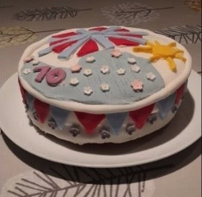
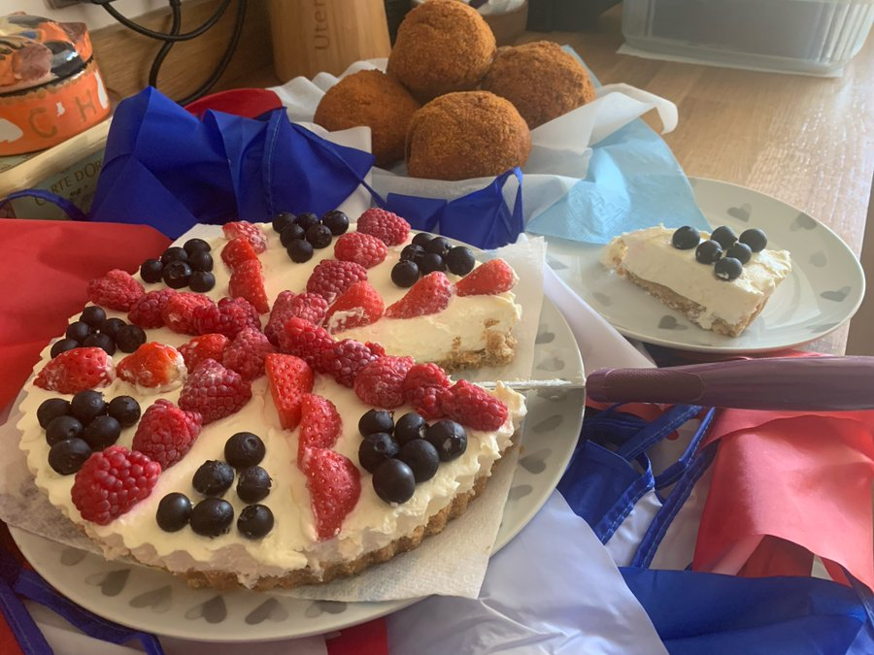
Food to Food to Celebrate the Queens
Food to Celebrate the Queens Jubilee
Competition Winners the Queens Jubilee Celebrate the Queens Jubilee
Rosie Evans – Year 8
Celebration Cake
Samuel Metcalf – Year 7
Cheesecake, Scotch Eggs & Pasta Salad

Slide 2
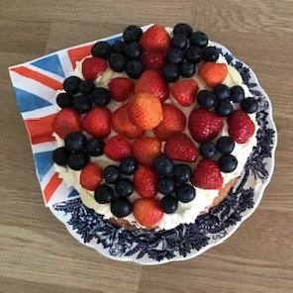
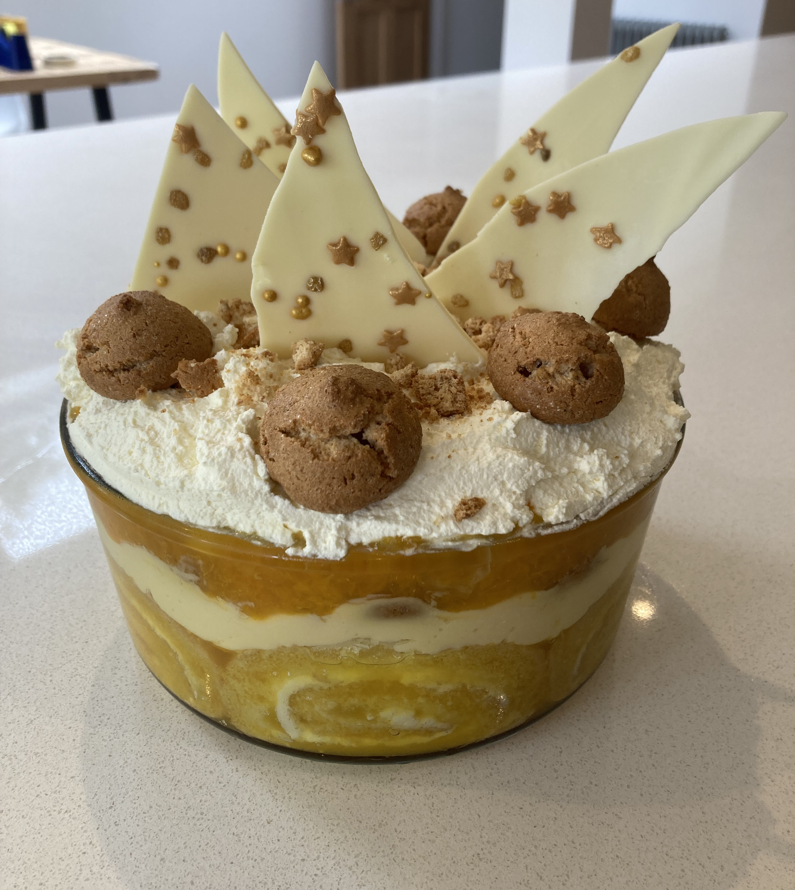
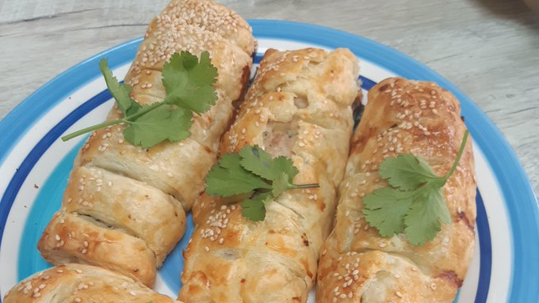
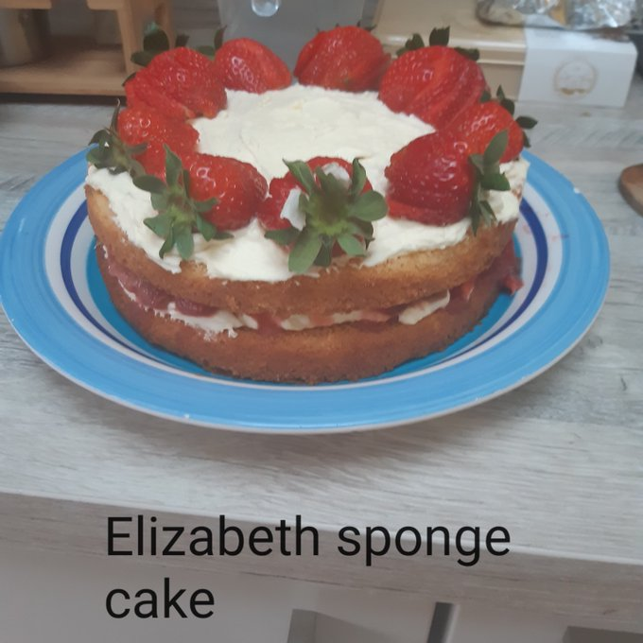
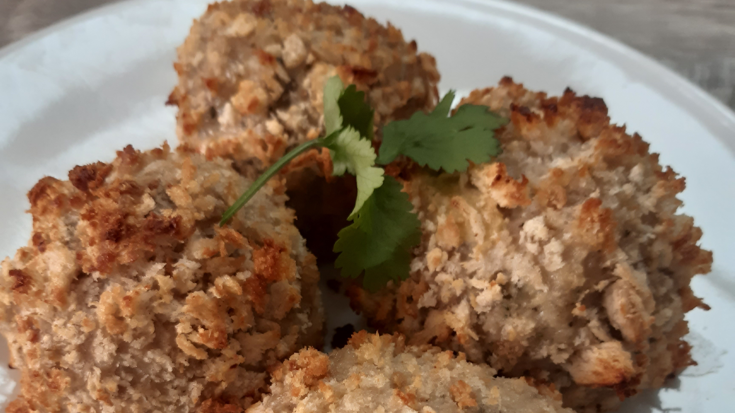
Highly Commended
Angela Griffiths – Year 7
Jubilee Cake
Ethan Gregg – Year 8
Jubilee Trifle
Zach & Sam Vassiliou – Year 9
Party Food:Sponge Cake,
Coronation Chicken Rolls
& Scotch Eggs

Slide 3
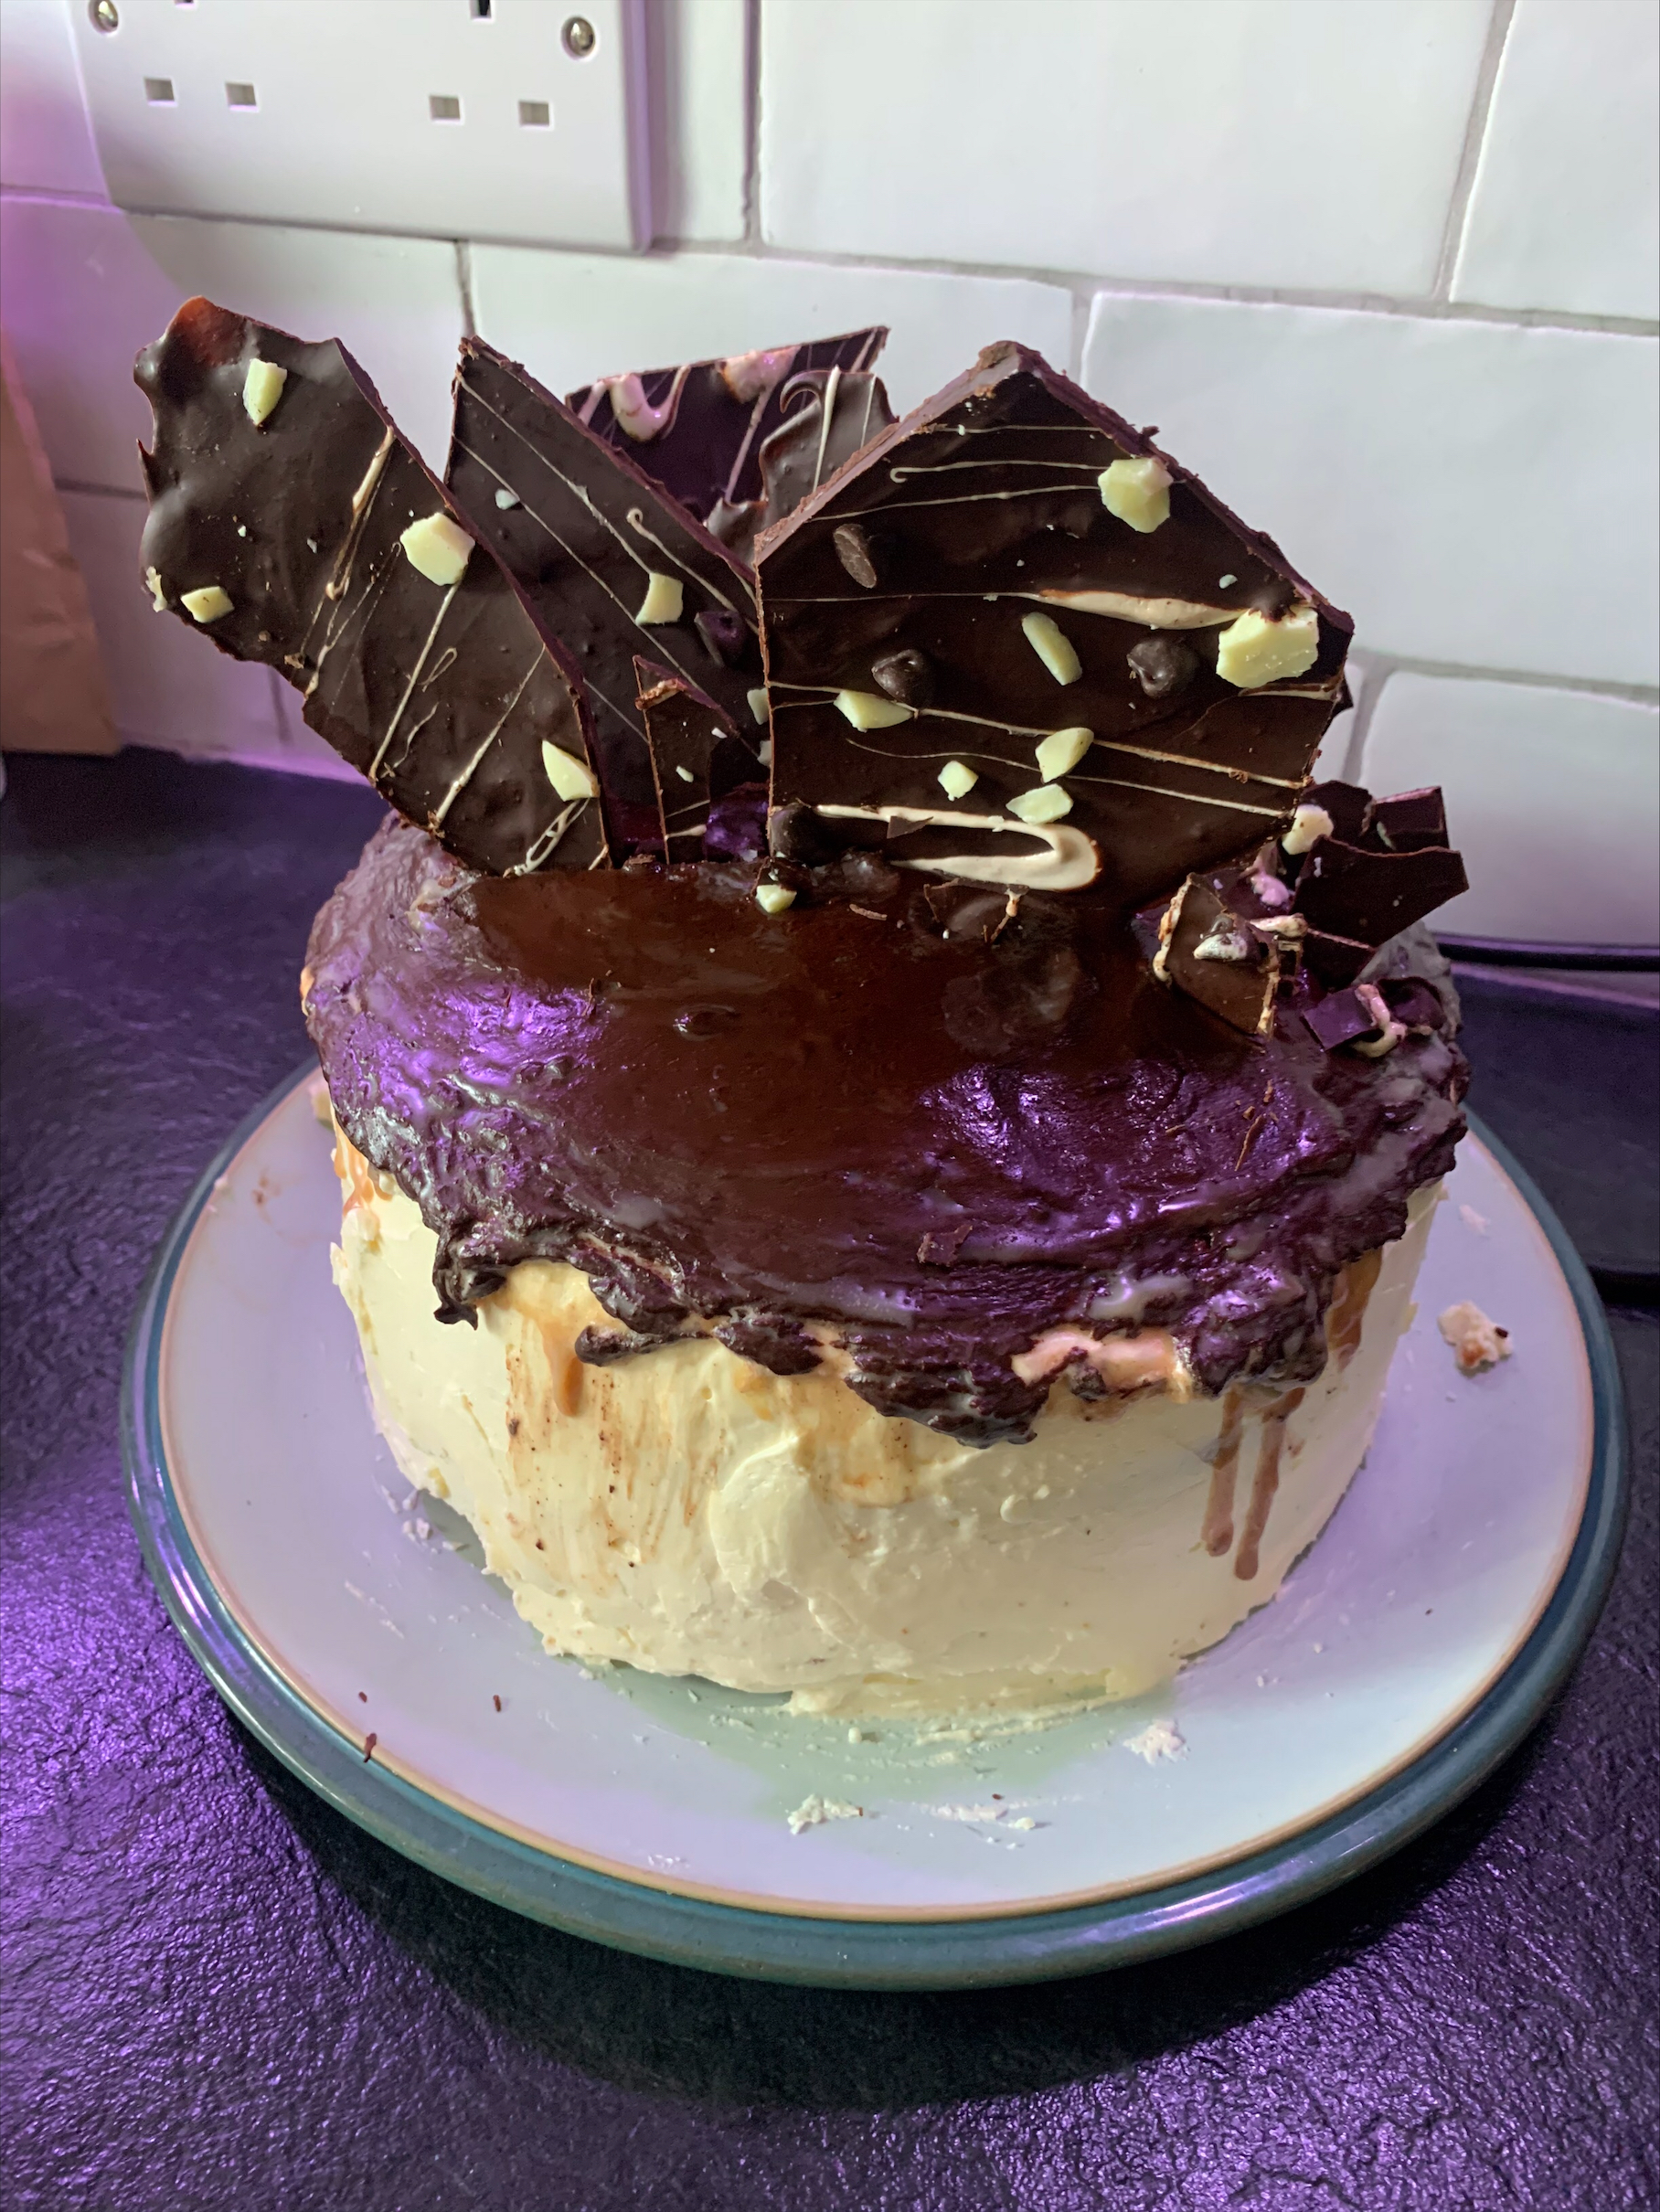
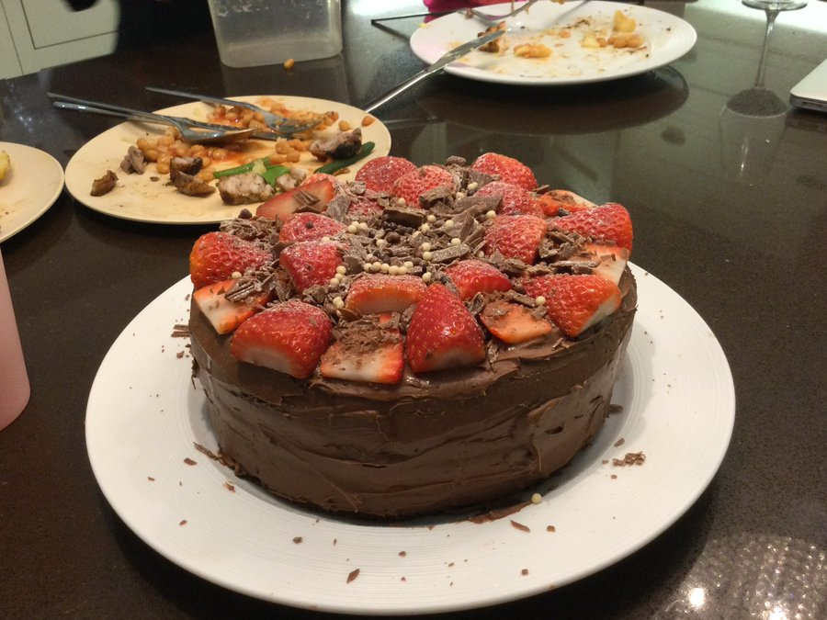
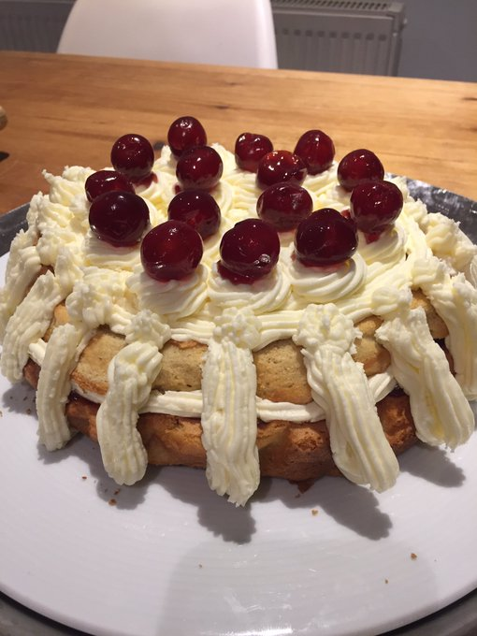
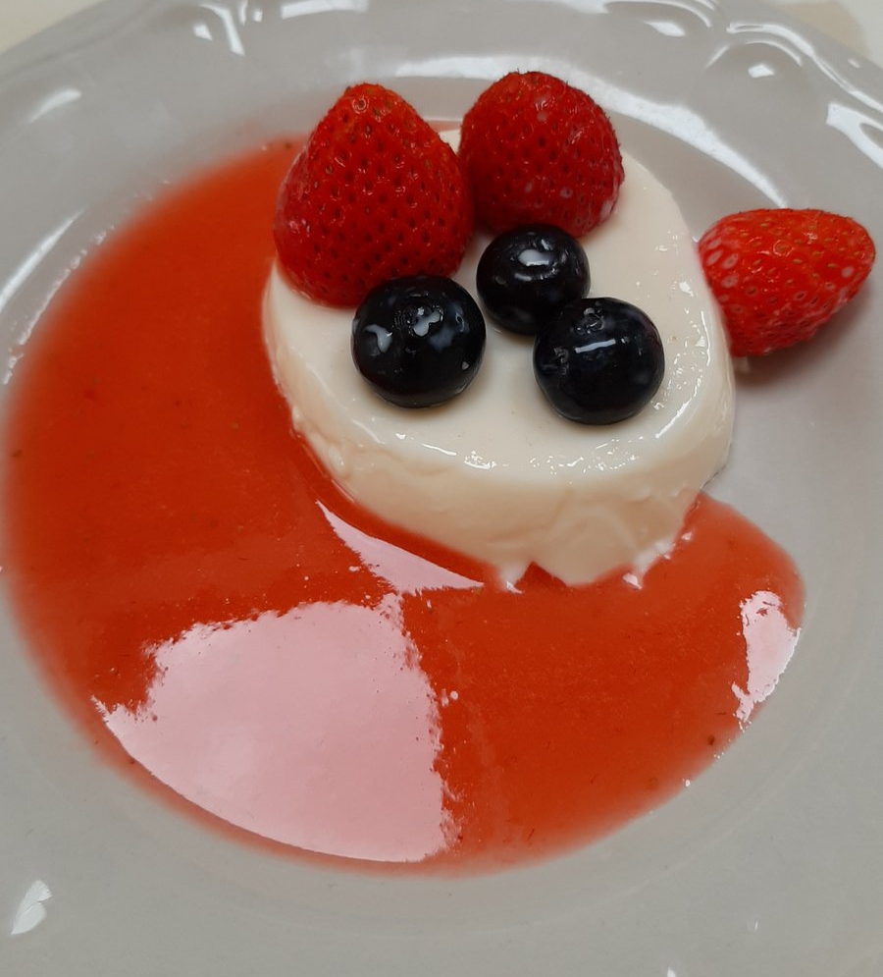
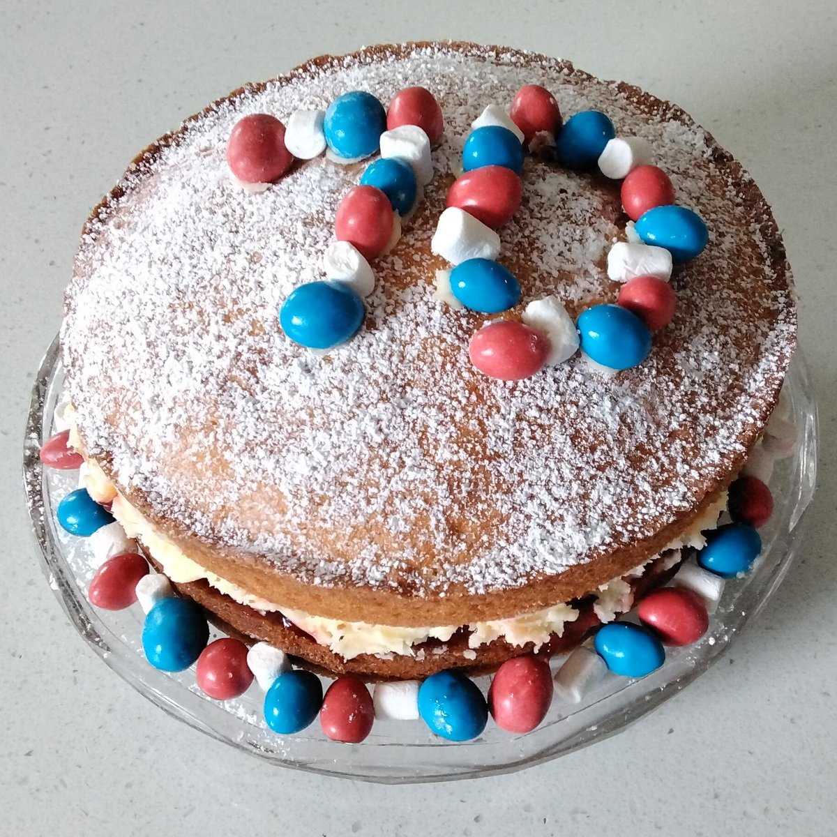
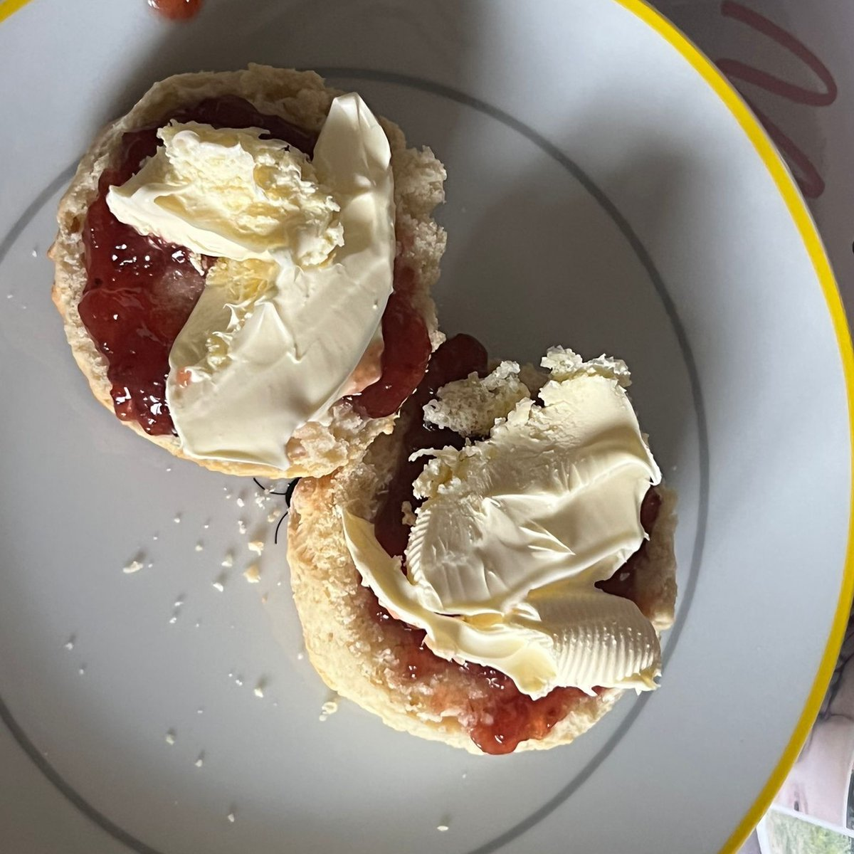
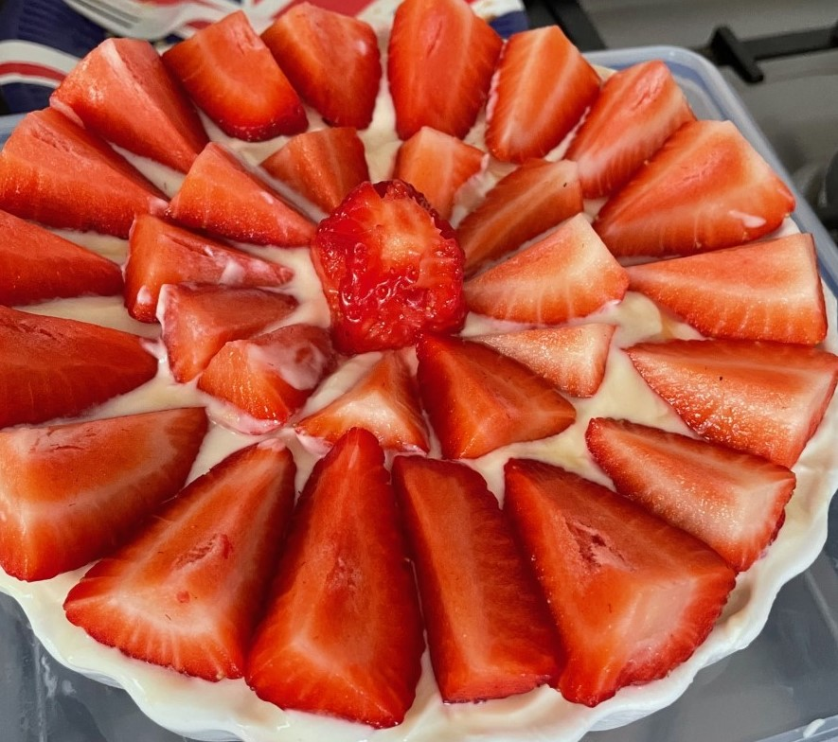
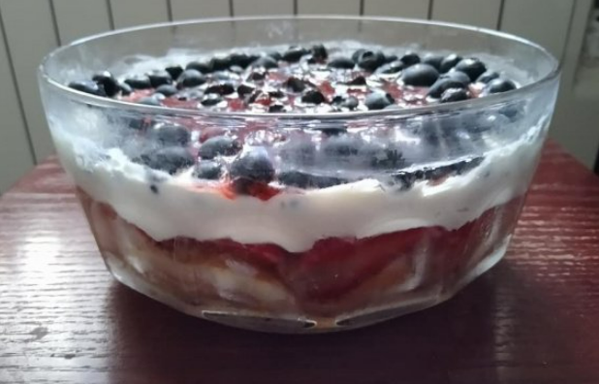
Food to Celebrate the Queens Jubilee

