Slide 1
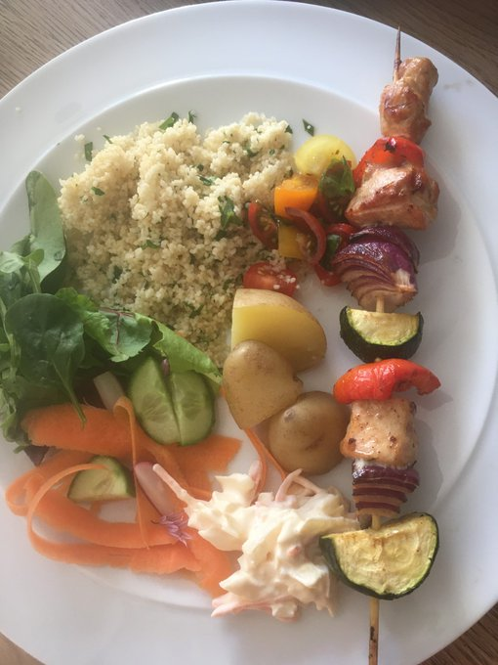
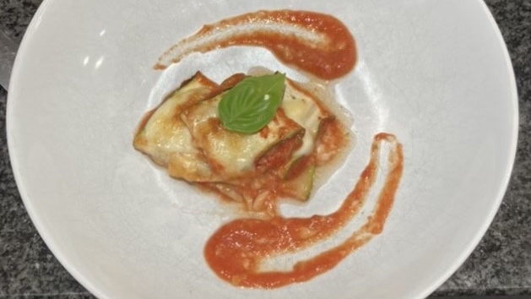
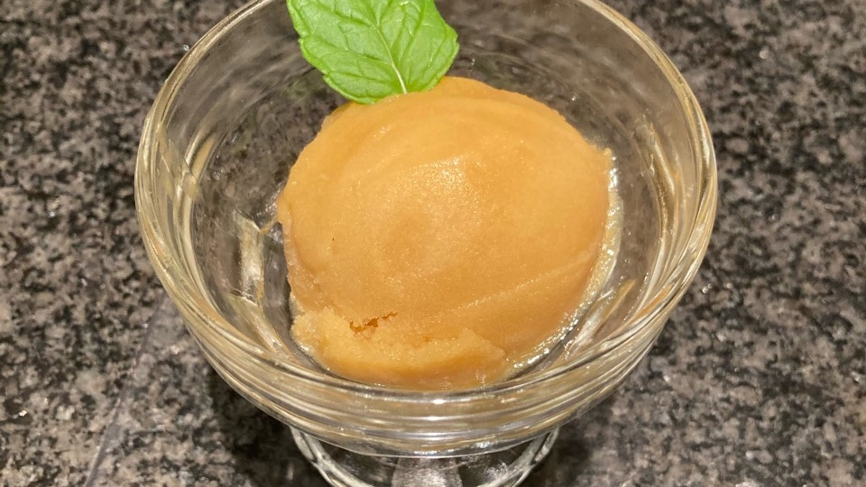

Summer Cooking Competition - Winners
KS3 - Amy Vernon Chicken and vegetable kebabs with a rainbow salad and cous-cous.
KS4 - Kaitlyn White Courgette Lasagne and Peach Sorbet
Well done to everyone who took part to celebrate Healthy Eating Week

