Slide 1
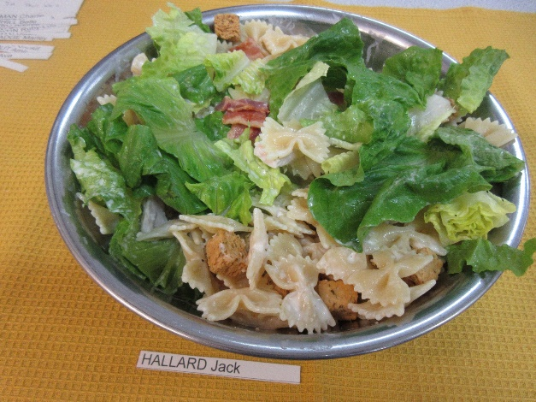
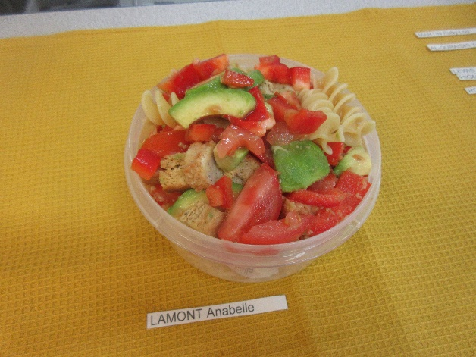
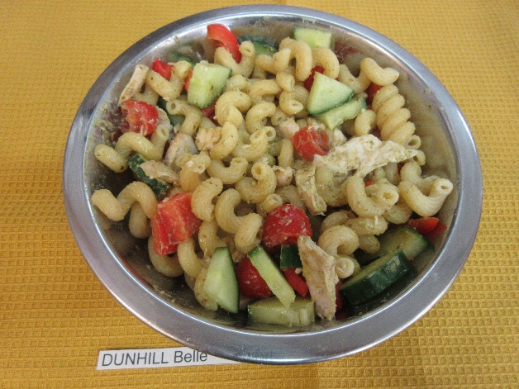
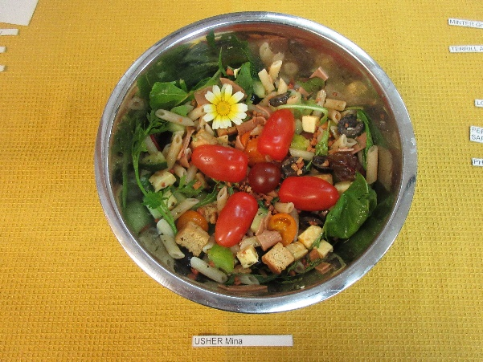
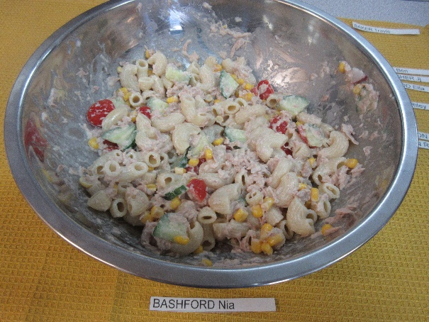
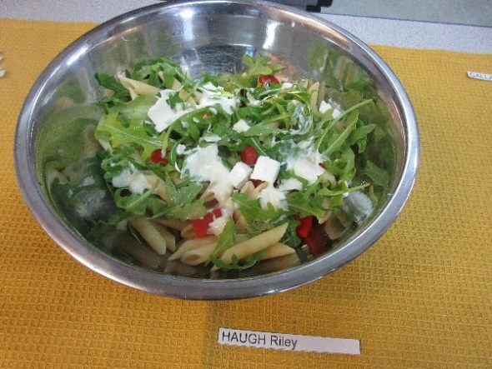
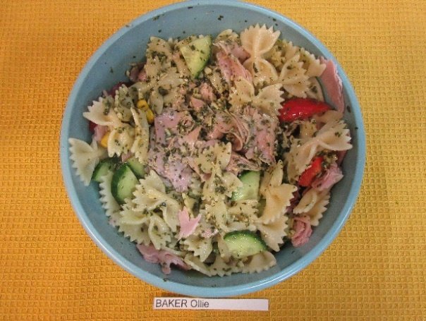
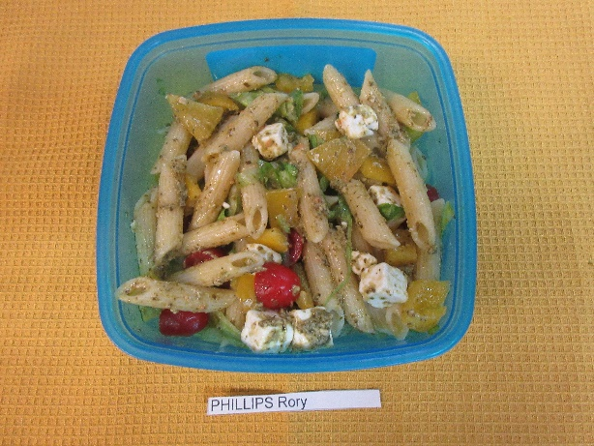
Year 7 Pasta Salads – Assessed Practical Task
Chicken, bacon, grated
cheese, 2 types of lettuce,
croutons, Caesar dressing
Chicken, tomato, red pepper,
avocado, croutons,
French Dressing
Chicken, cucumber, red pepper, cherry tomato,
mayo mixed with green pesto
Vegan ham and cheese,
2 types tomato, olives, baby
salad leaves, edible flowers
Tuna, sweetcorn, cucumber,
Tomato, and mayonnaise
Feta cheese, rocket, tomato
Red pepper, Caesar dressing
Ham, cucumber, tomato,
Sweetcorn, pesto
Cheese cubes, tomato,
yellow pepper, shredded
Lettuce, pesto

Slide 2


To celebrate National Healthy Eating Week…..
Some of your Pasta Salads are going on the canteen menu! Which will you buy?
Well done year 7! We had great fun choosing which ones:
Chicken, bacon, grated
cheese, 2 types of lettuce,
croutons, Caesar dressing
Feta cheese, rocket, tomato
Red pepper, Caesar dressing
Ham, cucumber, tomato,
Sweetcorn, pesto

