Slide 1
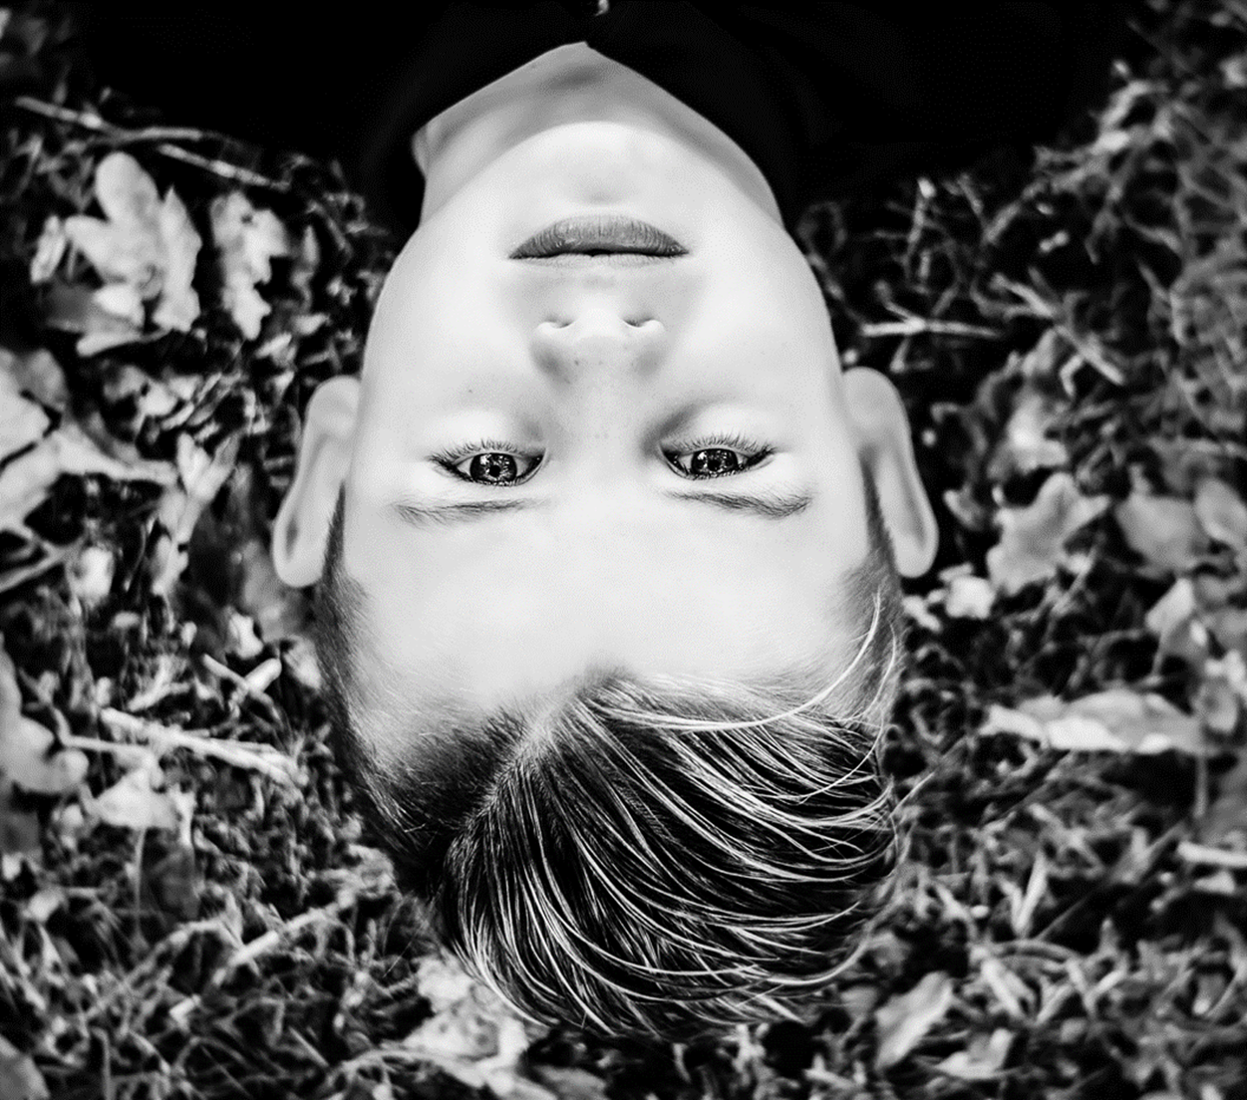
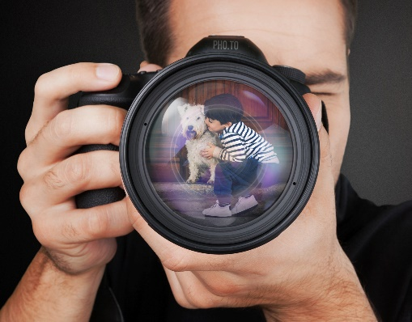
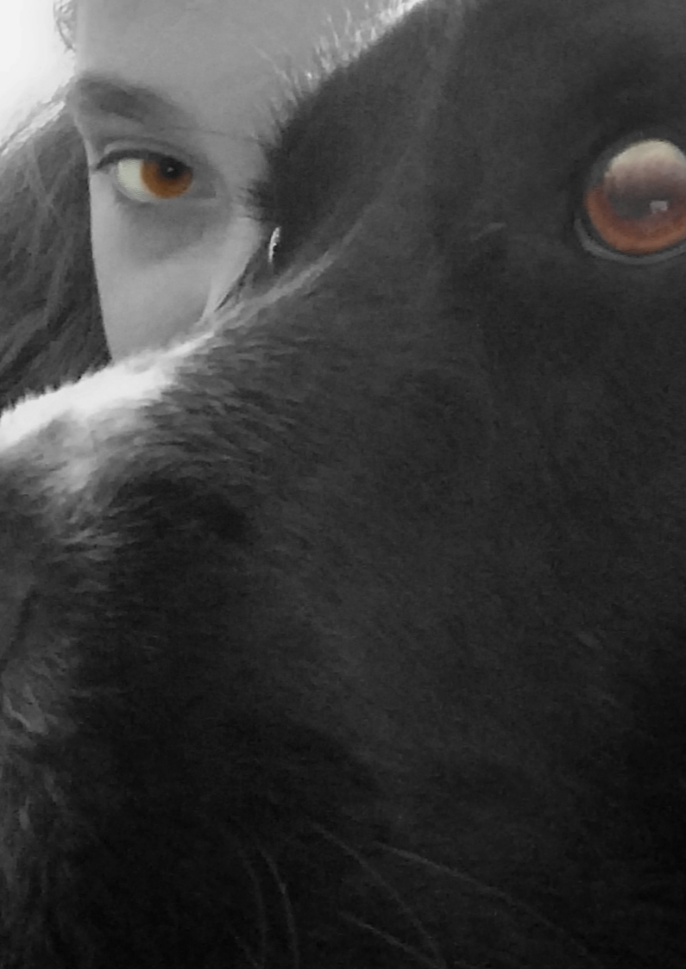
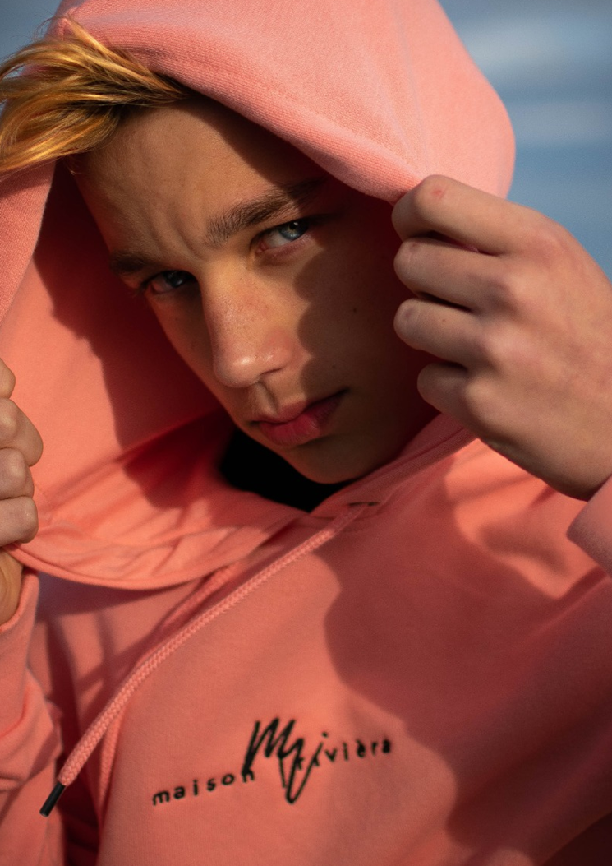
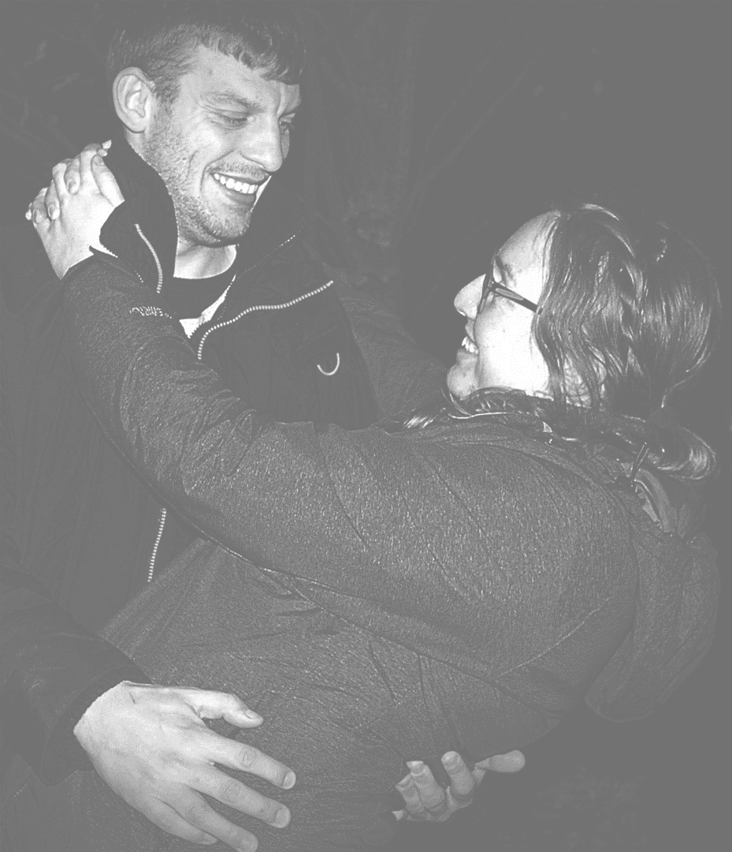
Year 9 Inter Community
Portrait Photograph Competition the Winners !
 | Points
Thankyou To Every student who participated | 1
1st place - Abi Paine 9S1 | 25
2nd place - Maya Mitoi 9T1 | 15
3rd Place - Zoe Miles 9H1 | 10
4th Place - Danielle Pike 9B1 | 5

Slide 2
The Winning Photograph was by
Abi Paine 9S1
Congratulations
What the Art department
Thought was really great about this image
Unusual viewpoint
Great tonal contrasts
Brilliant depth of field
Highly detailed in perfect focus
Great composition

