Slide 1
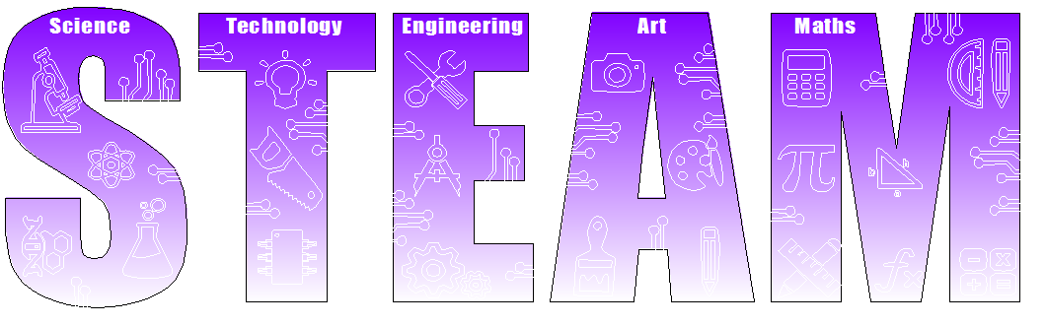
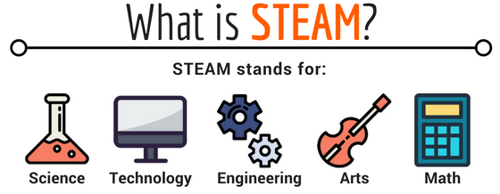
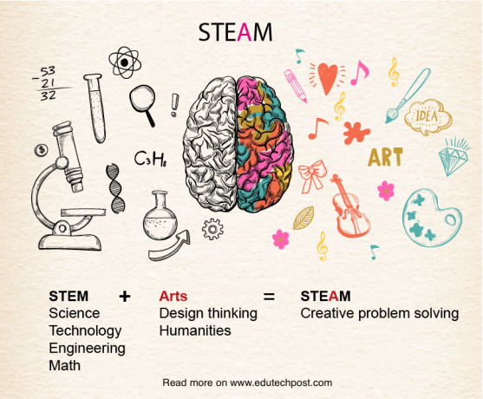

STEM has evolved into STEAM. STEAM is important, within the next 5 years there will be a demand for employees with STEAM skills.

Slide 2
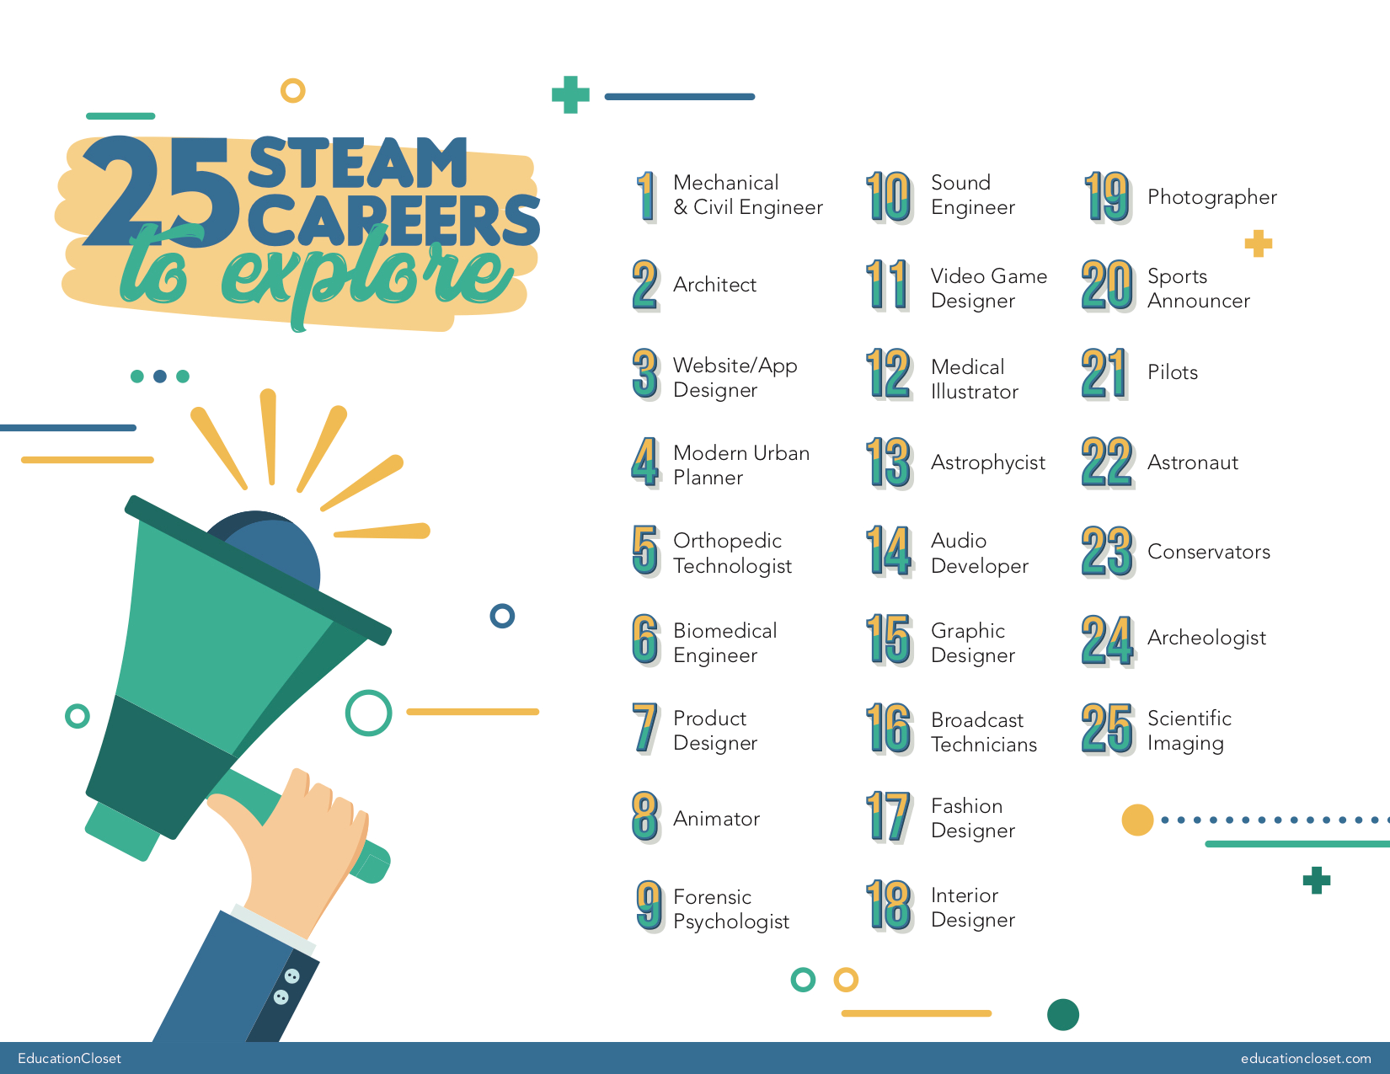
There are a huge number of STEAM related jobs, some are listed below.

Slide 3
Club Activities
If you are interested in a STEAM career or just want to learn more get involved in the STEAM club.
Each term there will be a different activity for you to get involved in during Wednesday lunchtimes in C10.

Slide 4
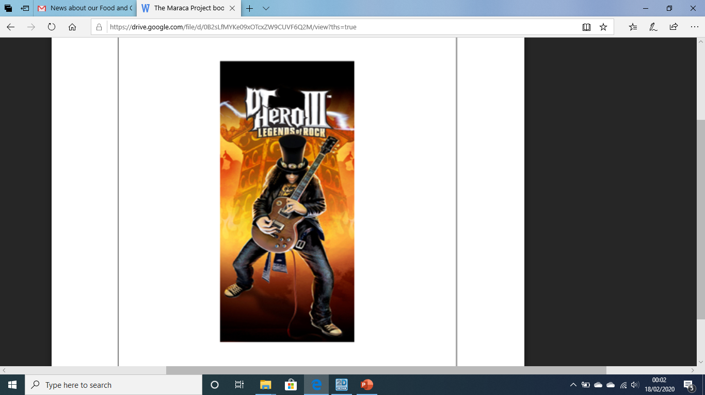

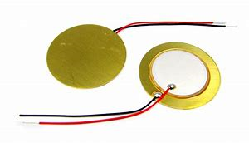
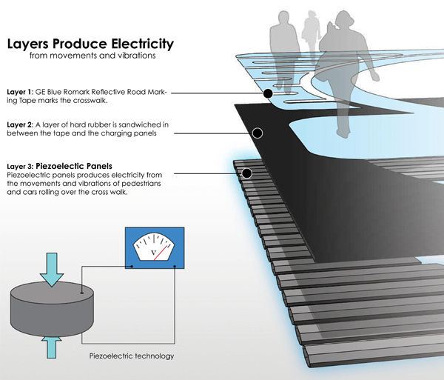
This terms STEAM challenge it to make your own electronic amp or instrument
What do guitars and street lights have in common? What does a piezoelectric disc do?
If you have ever wanted to make your own electric pickup (used to amplify sound signals) then come to C10 Wednesday lunchtimes to make your own amp. This pickup can be used to turn acoustic instruments into electric ones (and can even be used with an effects pedal!).
Can you take it a step further and create your own electronic instrument? Bring in an old electronic toy to learn about circuit bending.
You don’t have to be good at Music to have a go, so if you are interested in having a go see Mr Ras in C10.

Slide 5

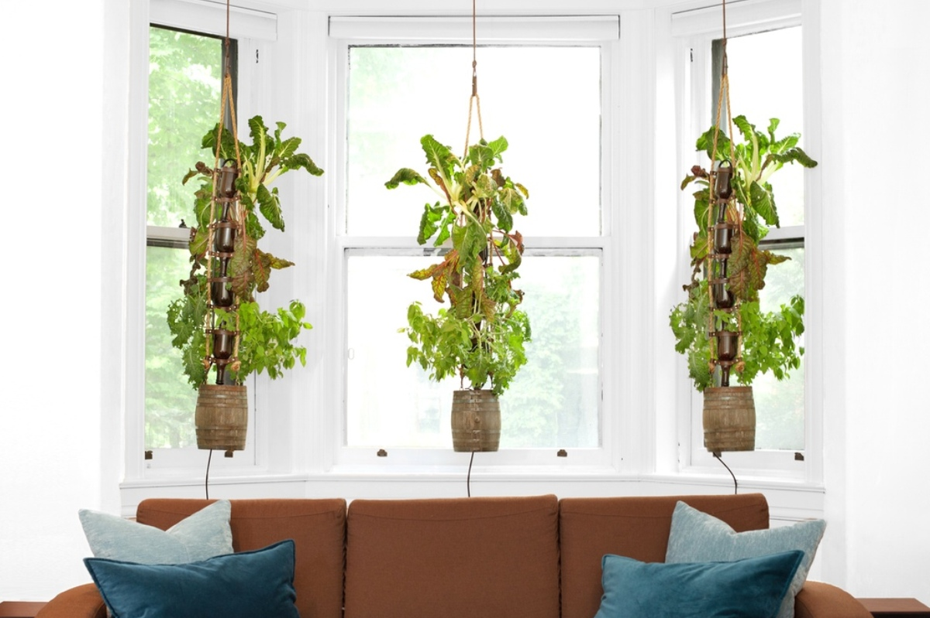
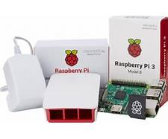
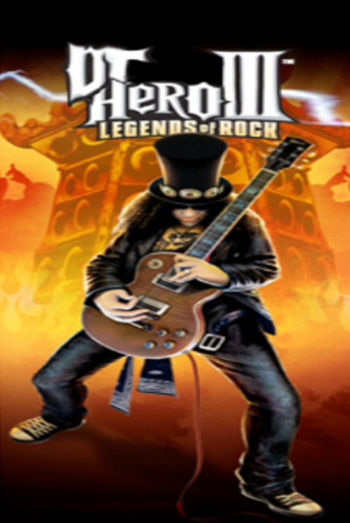
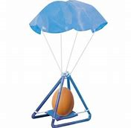
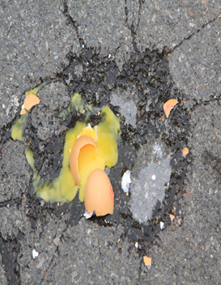
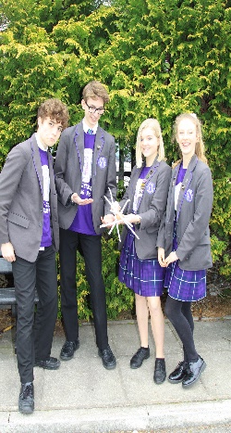
This week
National Science week
Activities
Tuesday : STEAM club. This Tuesday after school in C8 stem club do you want to grow your knowledge of how hydroponics may be a useful thing. See Mrs Petrie for more details.1
Alternatively learn to programme a Raspberry Pi with Mr Uddin in coding club in D4 3.15 – 4.15
Wednesday lunchtime C10: STEAM club. Piezoelectric amp and instrument challenge. See Mr Ras for more details1
Wednesday afterschool STEAM club in M5.
Egg Drop: Over the week build your egg-citing egg protector to stop your egg cracking when thrown from M Block. Build it at home and compete on Friday. If you need resources then on Thursday lunchtime come to STEAM club to construct your entry (C8). See Miss Miah, Mr Allen or Mr Ras for more details

Slide 6
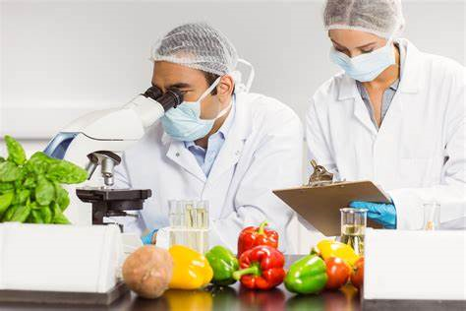

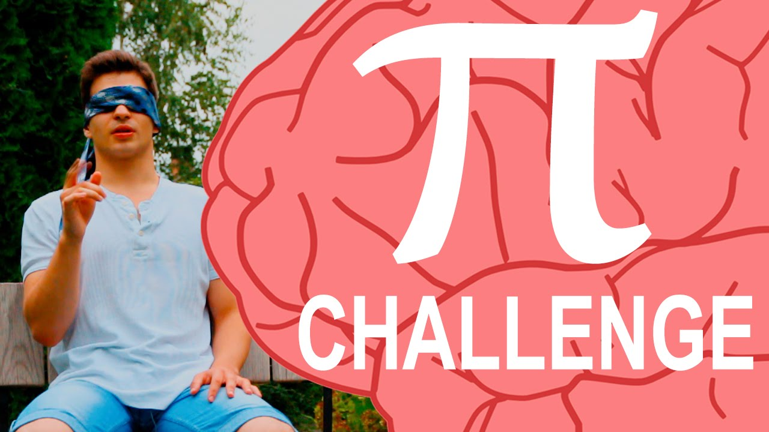
National Science week
Activities
Thursday afterschool in T5 3.15-4: Are you a supertaster? Supertasters experience bitter tastes more strongly than other people; this is because they have a higher number of taste receptors within the ‘fungiform papillae’. Come test out your taste buds in T5. See Mrs Whittby for more information
Thursday lunchtime and afterschool 3.15 – 5.20 : STEAM club. Enjoy Science fiction movies. Come and watch Tron Legacy in C10. "I fight for the Users." ―Tron. Tron is the story of a programmer trapped in a digital game world . Popcorn provided!
See Mr Ras for details
Cinema
Friday lunchtime: Pi Day Recital. Can you take the Pi Recital crown and remember the most digits of Pi. The current record is 314 digits! Prize money for the top 3! See Mr Garrad in the Millennium Hall
Friday afterschool C2: Egg Drop competition! Can your egg stand the test? Have a cracking time! See Miss Miah for details

Slide 7
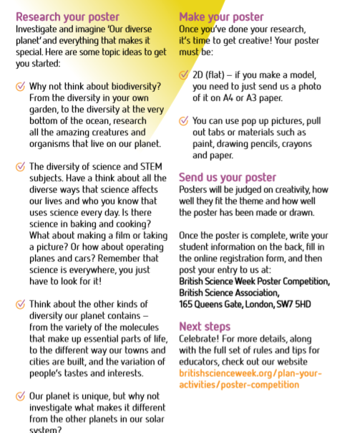

Interested in Biodiversity and like being creative? Why not enter the National British Science poster competition? All entries must be submitted to Mrs Hunt by March the 3Oth so that the top five designs can be entered and sent off to meet the closing date. See Mrs Hunt for details
(entries need to arrive by 6:00pm on Friday 3 April 2020)
Prizes are still to be confirmed ☺

Slide 8
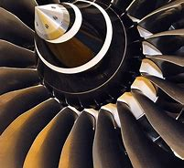
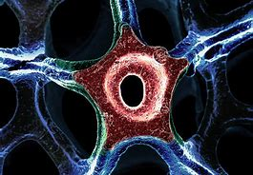
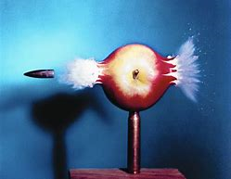
Steam Photography/Art competition. Are you interested in photography and STEAM. Take a picture or create an image that relates to STEAM. All entries to be sent to Mrs Hunt by 23 March and the winners will be announced shortly after.
Prizes are still to be confirmed ☺
STEAM Creative Beach Clean and Photography Workshops on Saturday 21 March 2020 10am – 2pm. Help clean the beaches from Shoreham-by-Sea to Worthing whilst getting involved some fun photography. See you work displayed in a gallery. See Mrs Hunt for details at Art club.

Slide 9
National Science week Steam Activities
Tuesday 3.15-4.15 C8 | Hydroponics workshop
Tuesday 3.15-4.15 D4 | Computer Science coding
Wednesday lunchtime C10 | DIY instrument pickup
Thursday lunchtime C8 | Egg Drop Build
Thursday Lunchtime in C10 and afterschool 3.15- 4.20 C10 | Tron Legacy STEAM movie
Thursday 3.15-4.00 T5 | Taste bud testing workshop
Friday lunchtime Millennium Hall | Pi recital competition and prize giving
Friday 3.15-4.00 C2 | Egg Drop competition- bring in your entry
Art competitions and activities | National Science Week Biodiversity competition STEAM photography competition STEAM beach clean at Art club and workshop on Saturday 21st March

