Slide 1
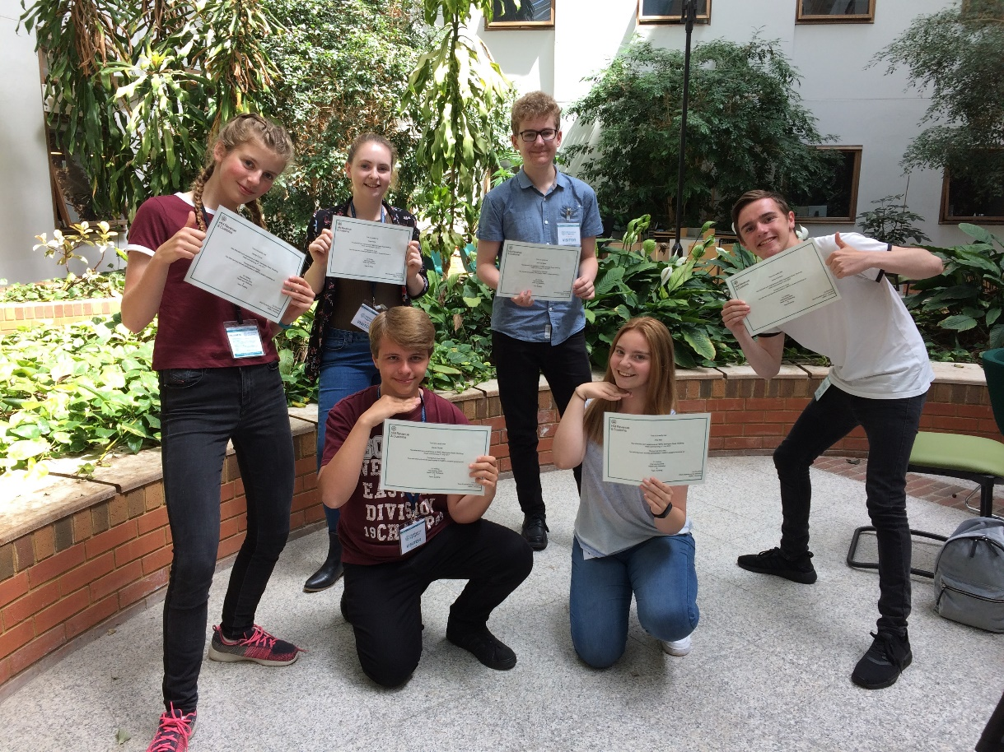

Work Experience 2020

Slide 2
Monday 29th June to
Friday 3rd July 2020

Slide 3
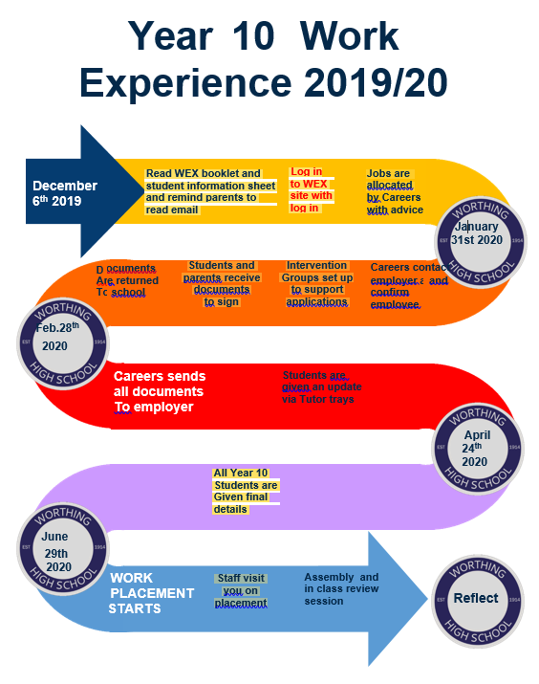

Slide 4
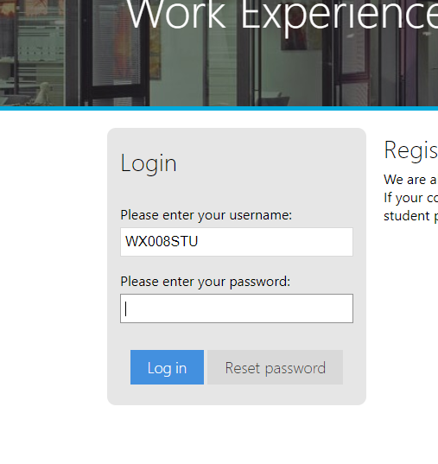
Overview…
Your child completes the online
request for the top three
positions they are interested in.
Parental letters will be emailed
tomorrow with full details. LINK www.northbrook.ac.uk/wex
2. Student can attend drop in sessions next week at lunch time (B3) to help chose their 3 ideal placements.
3.Students may be given an application form to complete for their preferred placement as some sought after placements will have an element of competition.
southfarm

Slide 5

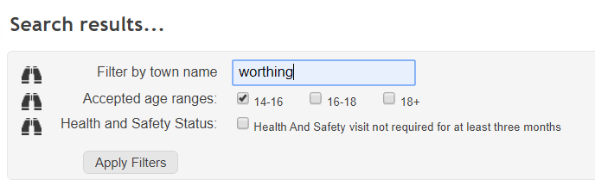
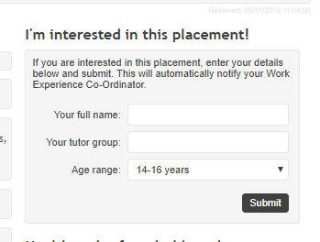
http://www.northbrook.ac.uk/wex/

Slide 6
Lunch time drop ins
B3
Monday 11th – Thursday 14th November
From 13.30-14.15
All Y10 welcome

Slide 7

Further notes for parents/carers
The online data base is to help the students decide what they want to do. This is not a live database and the positions it states are only confirmed by the careers advisor.
STUDENTS AND PARENTS MUST NOT CONTACT THE COMPANIES LISTED IN THE DATABASE.
You will be contacted by email from this point onwards at key times of the year.

Slide 8
Additional Information
Sussex Police
Rolls Royce
Privately arranged placements
  H&S checked required West Sussex £30 – elsewhere min £50 completed by Northbrook or their partner college.

