Slide 1
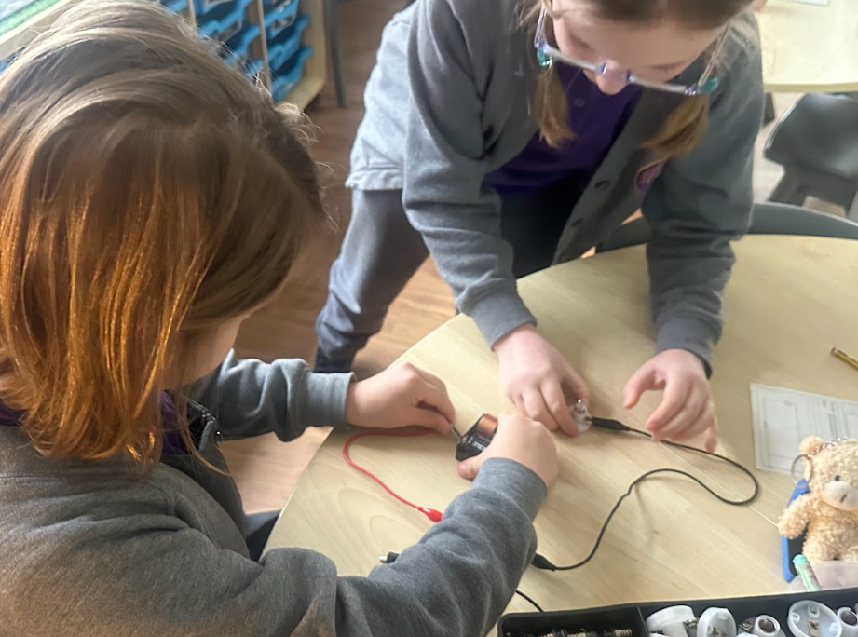
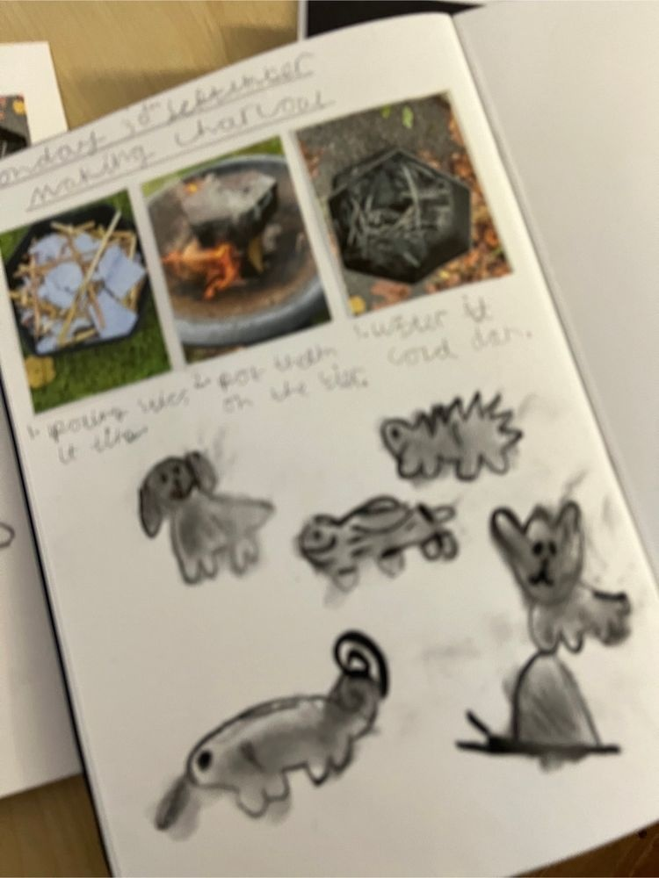
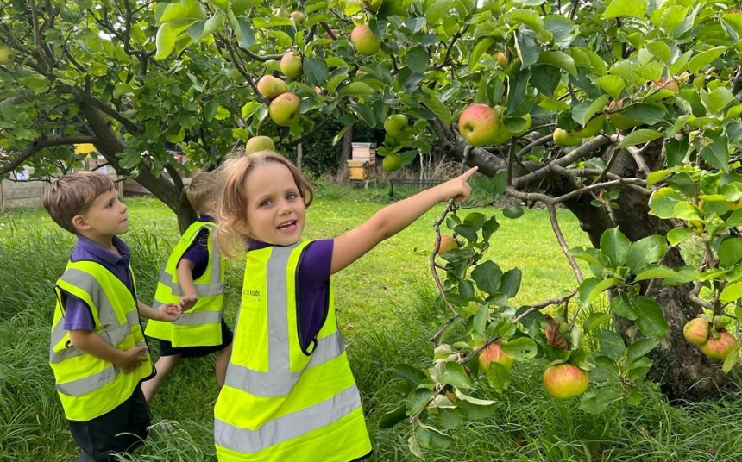
So Why Choose Teaching?
‘

Slide 2
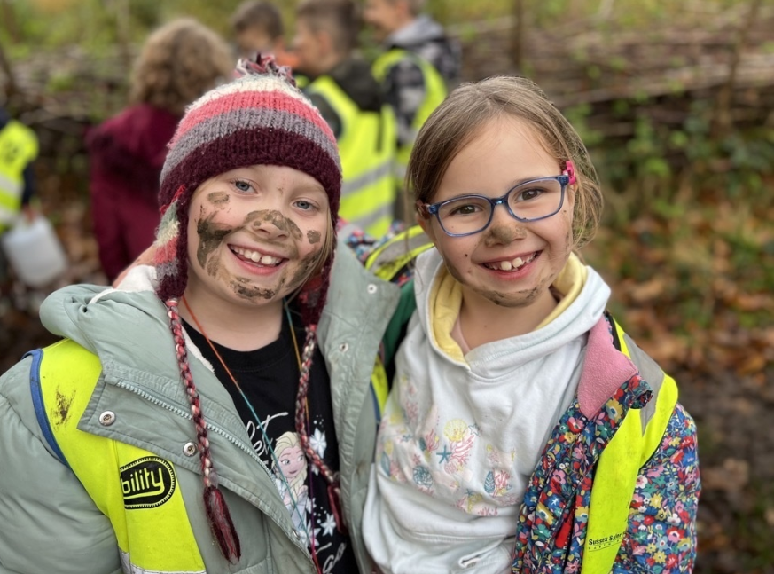
Introduction
A primary school teacher plays a crucial role in shaping young minds.
They teach core subjects such as maths, reading, writing, and science, and also all the foundation subjects.
Essential qualities include patience, creativity, adaptability, and strong communication skills.
Teaching young children can be highly rewarding as you help them build confidence and a love for learning.

Slide 3
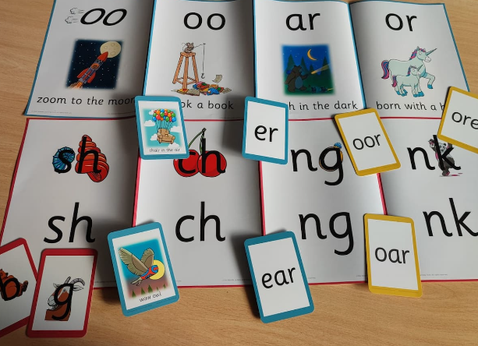
Daily Responsibilities
Planning engaging and interactive lessons that meet curriculum standards.
Teaching a variety of subjects across the curriculum.
Encouraging creativity through arts, music, and physical education.
Managing classroom behaviour using positive reinforcement strategies.
Assessing student progress through observations, outcomes and attainment.
Communicating regularly with parents.
Supporting students’ emotional and social growth by creating a positive learning environment.

Slide 4
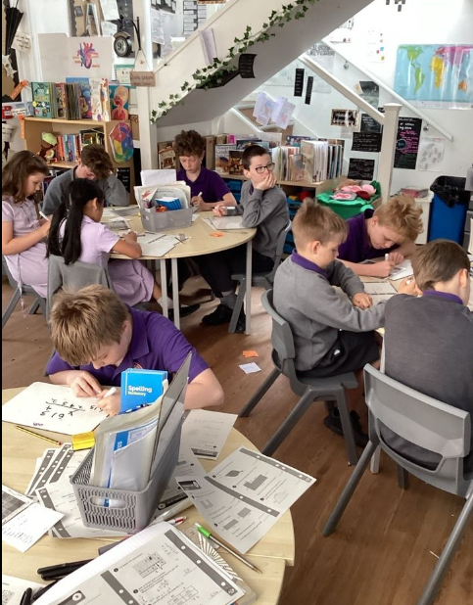
A Typical Day
Morning Preparation: Reviewing lesson plans, setting up resources, check emails and safeguarding alerts, liaise with support staff, welcome children
Classroom Instruction: Delivering assembly, teaching a range of subjects, feedback to pupils, assessing and adapting learning and planning next steps.
Break Time Duties: Supervising children at playtime and ensuring safety.
Lunchtime: Marking morning outcomes, preparing resources for afternoon lessons, check emails and safeguarding alerts.
Afternoon Learning: Continue to deliver a broad range of subjects and assess learning.
After School: Meeting with parents, marking, CPD, and planning for the next day, classroom displays, check emails and safeguarding alerts.

Slide 5
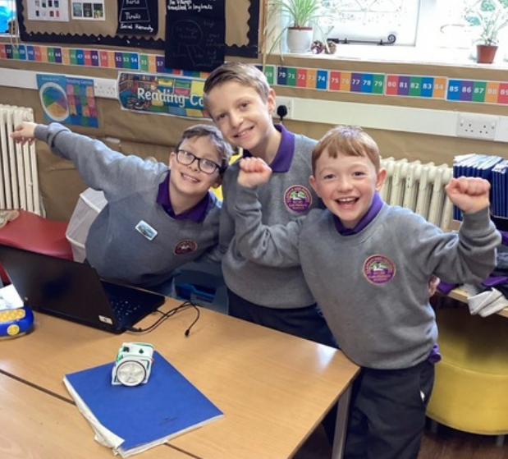
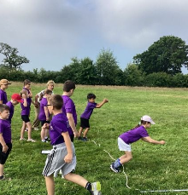
Key Skills You Need
Strong Communication: Explaining concepts clearly to young children and collaborating with parents and colleagues.
Creativity: Creating high quality creative lessons to engage learners whilst based on planned earning objectives .
Problem-Solving: Managing classroom challenges and finding solutions for different learning needs.
Patience & Adaptability: Understanding that every child learns at their own pace and adapting teaching strategies accordingly.
Organisation & Time Management: Balancing lesson planning, marking, feedback, meetings, learning environments and deadlines.

Slide 6
Education and Training
Educational Requirements: Bachelor’s degree in education or a related field.
Training & Certifications: Teaching qualifications such as a Postgraduate Certificate in Education (PGCE) or equivalent.
Practical Experience: Gaining hands-on experience through internships and student-teaching programs.
Ongoing Professional Development: Attending workshops and training to stay updated with new teaching methods.
Secondary teaching - GCSEs 4+ including english and maths
Primary teaching - GCSEs 4+ including english, maths and science

Slide 7
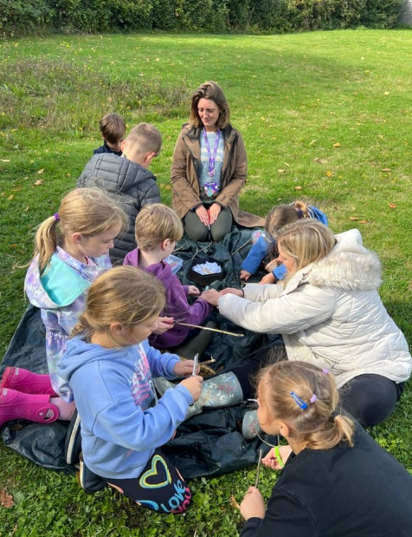
Challenges of the Job
Managing Different Learning Needs: Adapting lessons to meet the needs of different learners abilities.
Keeping learners Engaged: Finding creative ways to maintain attention and interest.
Handling Classroom Behaviour Issues: Using effective strategies to create a respectful and disciplined environment.
Pedagogy: Understanding of a range of teaching and learning methods
Balancing Workload: Managing lesson planning, marking, and administrative tasks.
Curriculum Changes: Staying updated with educational reforms and implementing new teaching strategies.
Subject Knowledge: Substantive and disciplinary knowledge of a subject area.
Accountability: Meeting expectations and being accountable for children’s progress, attainment and wellbeing.

Slide 8
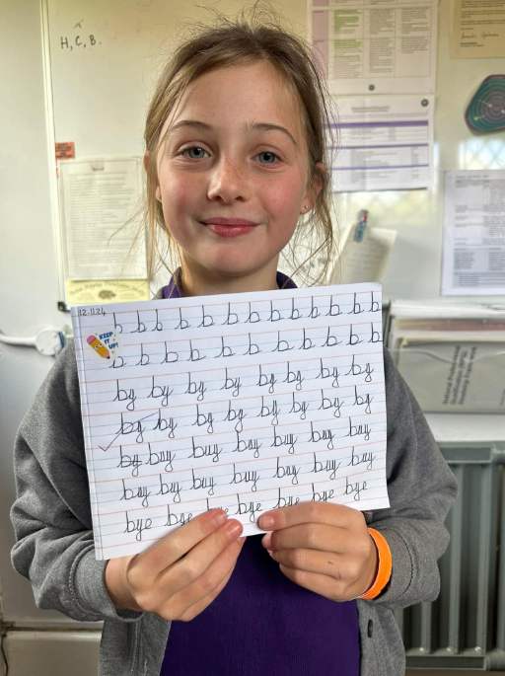
Rewards of Being a Teacher
Making a Difference: Helping children grow academically and personally.
Seeing Progress: Watching students improve their skills and confidence over time.
Individualism: Opportunity for creativity and outward thinking.
Community: Valued part of the school community.
Job Stability: Teaching is a profession with long-term career security and demand.

Slide 9
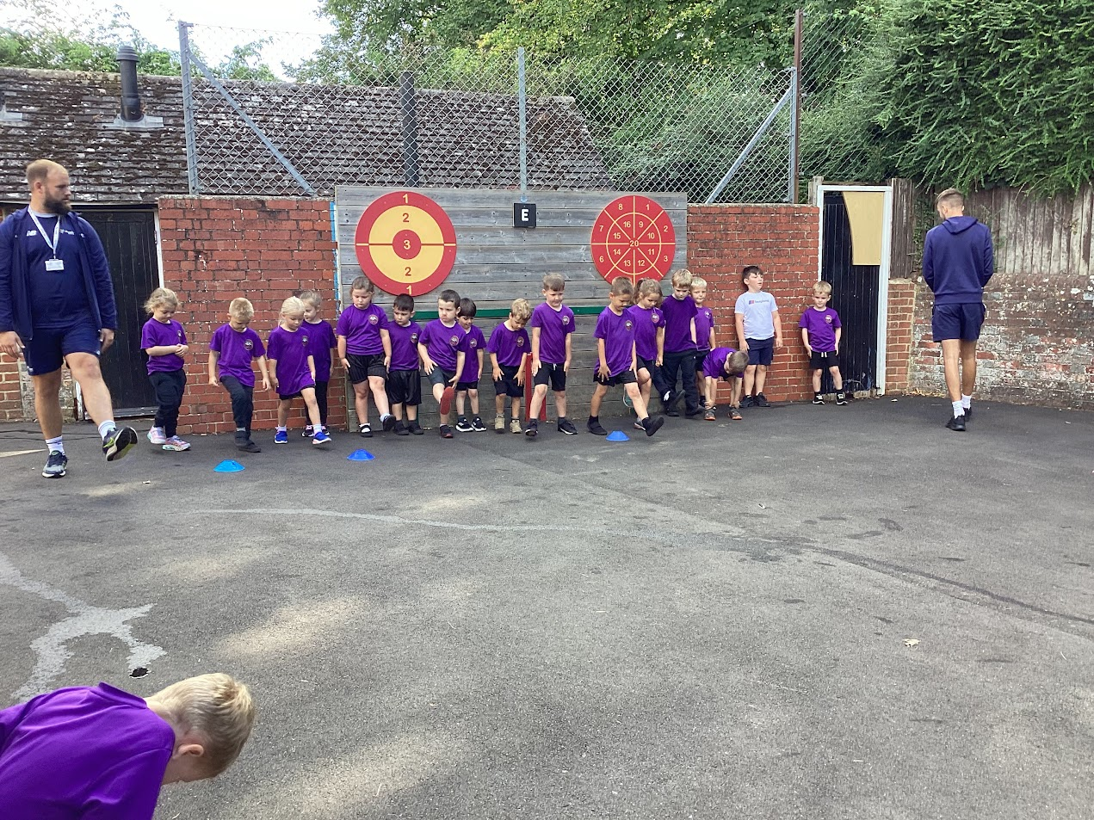
Career Pathways and Opportunities
Leadership Roles: Becoming a headteacher, assistant principal, or school administrator.
Specialisation: Focusing on special education, literacy coaching, or subject-specific teaching.
Educational Consulting: Advising schools on curriculum and teaching strategies.
Teaching Abroad: Working in international schools or participating in exchange programs.
Online Education: Exploring remote teaching or developing digital learning materials.

Slide 10
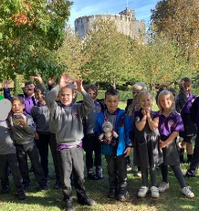
Conclusion & Questions
Teaching is a challenging but fulfilling career that requires dedication, quick thinking, subject and pedagogical knowledge, creativity, curiosity and a huge amount of patience!

