Slide 1

Hello!

Slide 2
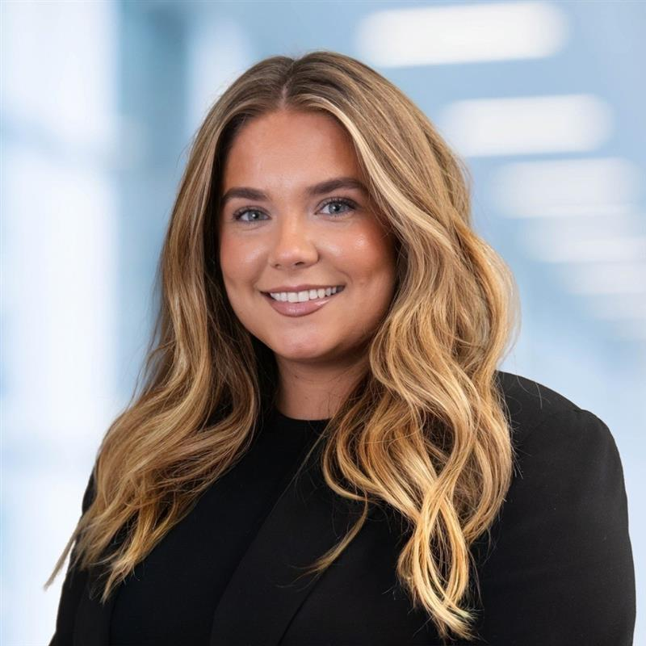
SANDRA’s Story
As a child I wanted to be:
Actress
My current role is:
SAP Functional Consultant
How did I get here
College
University
IT/Cybersecurity recruiter
Joined Capgemini as a graduate
How does my job inspire me?
Opportunity for continuous learning
Chance to make a tangible impact
Positive colleague relationships
What would I like to do in the future?
Solutions architecture
Developing Early and Emerging talent

Slide 3
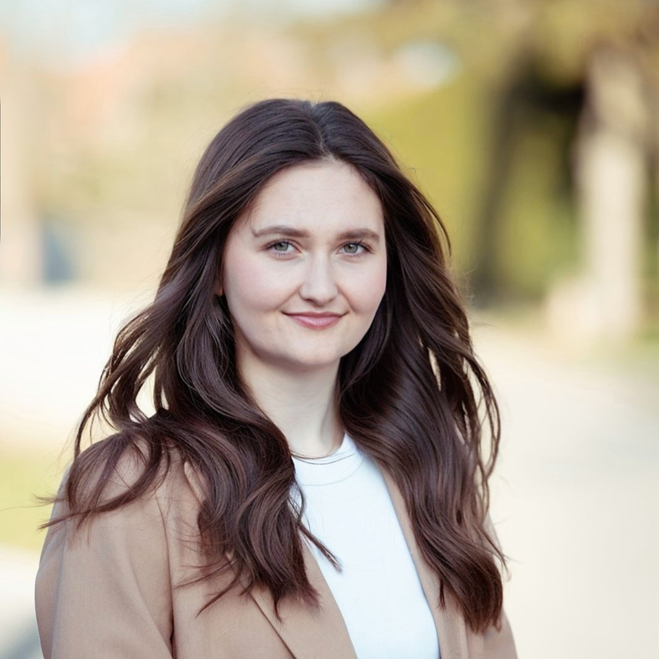
ROSIE’s Story
As a child I wanted to be
Vet
My current role is
Software engineer
How did I get here
A levels at college
Didn’t want to go to university
Joined as a degree apprenticeship
How does my job inspire me?
Constantly challenged
Giving back to early talent
What would I like to do in the future?
People management
Driving innovation and change

Slide 4

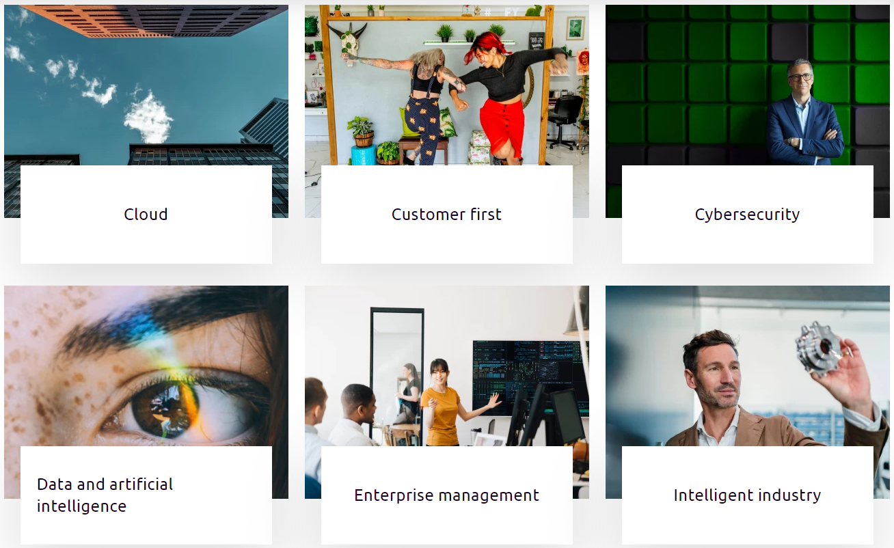
Who are we and what do we do?
ONE TEAM
Capgemini is present in more than 50 countries and more than 120 nationalities
340,000+ people worldwide working
together as one team*

Slide 5






















LOTS OF CLIENTS

Slide 6










HMRC – our biggest client in Telford and Worthing, but who are they?
(His Majesty’s Revenue and Customs)
£786.6 billion
Notes:
Plane – Fuel Tax
Trolley – Value Added Tax on goods or services
Person – Income Tax
All of these things are to raise government revenue that then allows you to pay for public services

Slide 7

DIGITAL & TECHNOLOGY SOLUTIONS PROFESSIONAL
DEGREE APPRENTICESHIP
Apprentices will be trained in a wide range of programming tools, methods and techniques. The course covers applied competence in the application of IT, promotes business awareness and delivers understanding of the issues central to IT organisations.
Duration:
36 months (3 years)
Job roles this programme is great for:
Applications Consultant
Business Analyst
Software Developer
Data Analyst
Entry requirements:
7 GCSEs A*-C including Maths and English (4-9)
3 A*-C at A-level (96 UCAS points) or equivalent
Sheffield Hallam is home to the National Centre for Excellence in Degree Apprenticeships, and is the UK's leader for providing higher and degree apprenticeships. The University has been awarded ‘Training Provider of the Year’ at this year’s South Yorkshire Apprenticeship Awards 2022.
Qualification:
BSc (Hons) in Digital & Technology Solutions

Slide 8
CHARTERED MANAGER DEGREE APPRENTICESHIP
Apprentices will be provided with a wide overview of business theory that can be applied in their day-to-day work. This includes operational strategy, project management and business finance. This apprenticeship is ideal for those who aspire to be managers in business.
Duration:
36 months (3 years)
Job roles this programme is great for:
PMO Analyst
Project Manager
Functional Consultant
Sales Associate
Entry requirements:
7 GCSEs A*-C including Maths and English (4-9)
3 A*-C at A-level (96 UCAS points) or equivalent
Sheffield Hallam is home to the National Centre for Excellence in Degree Apprenticeships, and is the UK's leader for providing higher and degree apprenticeships. The University has been awarded ‘Training Provider of the Year’ at this year’s South Yorkshire Apprenticeship Awards 2022.
Qualification:
BSc (Hons) Professional Practice in Management
Chartered Status from the Chartered Management Institute (CMI)

Slide 9
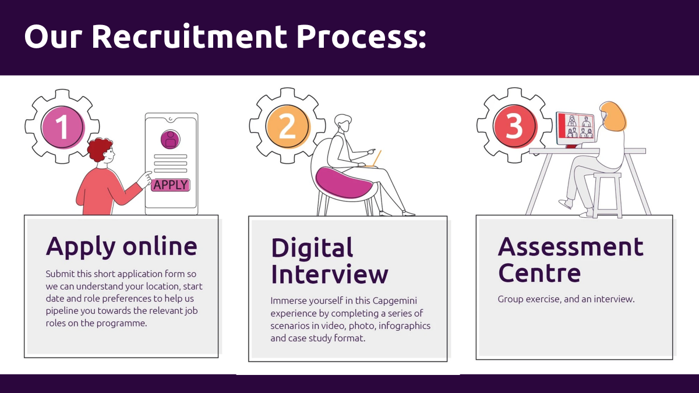

Slide 10

Any questions?

