Slide 1

The veterinary Profession
Is this a Career for you?

Slide 2
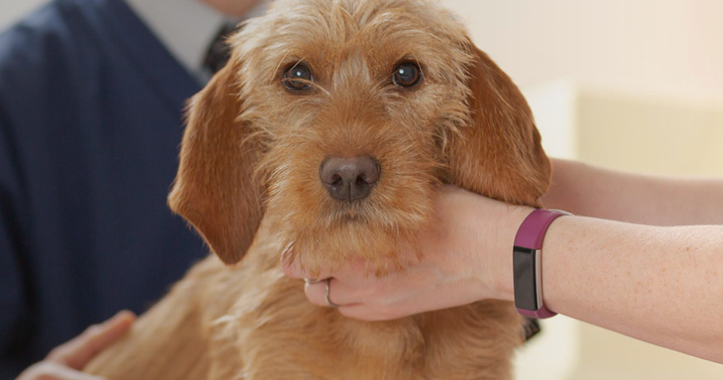
Who Are Grove lodge Vets?
We are a locally based professional veterinary care provider which offers a 24 hour care for pets in East and South Sussex.

Slide 3
Veterinary care assist
Veterinary surgeon
Veterinary nurse
Job Types with the profession
Clinical researcher
Laboratory Technician
Practice manager
Receptionist
Human resources

Slide 4
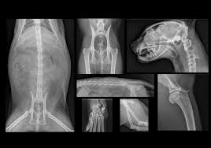
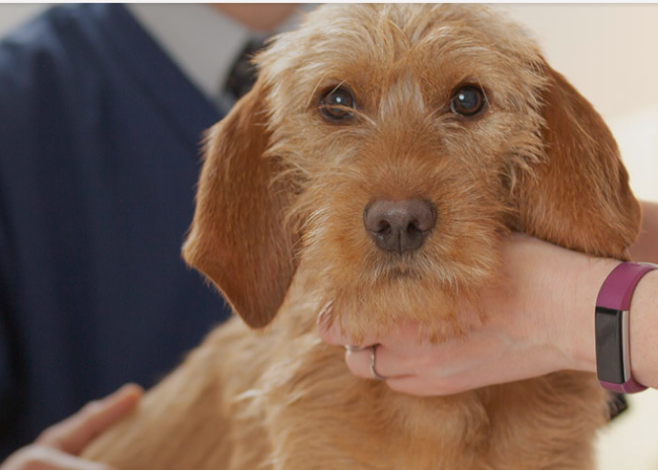
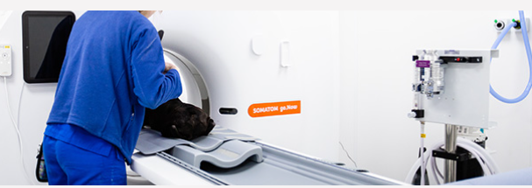


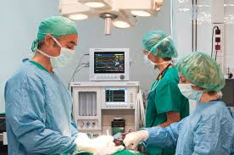
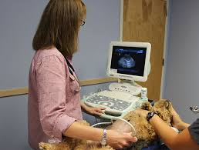

Slide 5
How to join the profession;
Veterinary surgeon
Veterinary Nurse
A level or equivalent
A level or equivalent
Veterinary care assist Job/ experience
Degree
Degree
Apprenticeship

Slide 6
Any Questions?

