Slide 1


Careers in Sussex Police
Sergeant Chapman EA842
Protect - Catch - Deliver

Slide 2

My journey in to Policing

Slide 3
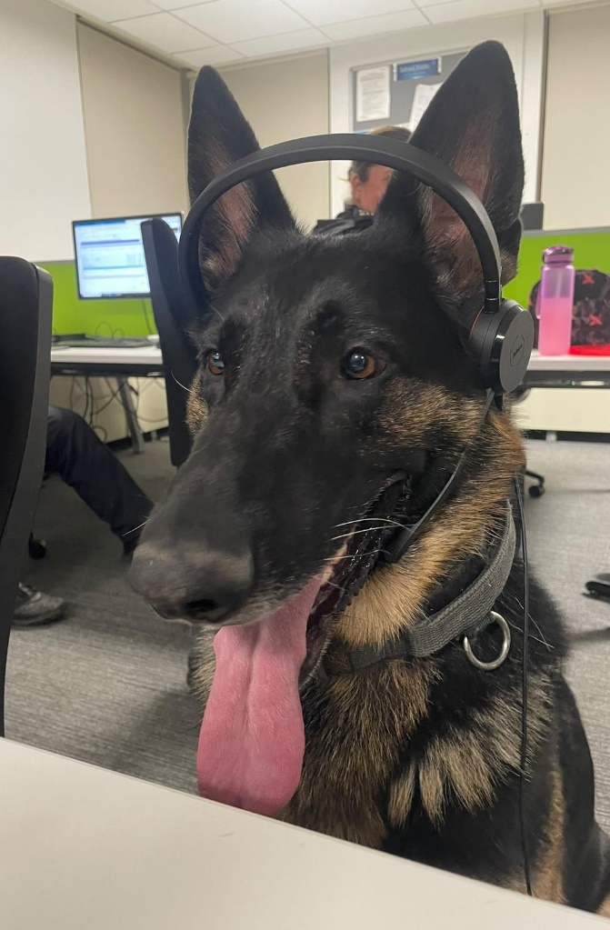

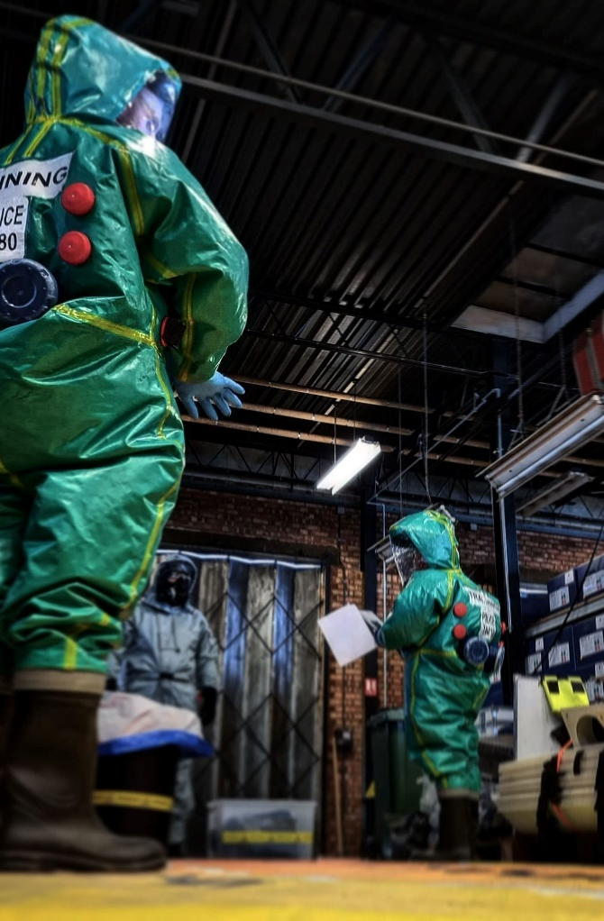
How many different roles do you think are in the police?
PSU Riot officer
Dog Handler
CSI Forensic Scientist
Detective
Firearms officer
Rural Crime
Drone operator

Slide 4
64
Different Jobs/Roles
484
Courses and specialisations

Slide 5
My role and specialisms
Response Sergeant
Specialisms:
STO
Interviewer
CBRN responder
Response driver
EBTI
Prison van driver
Advanced first aid
PSU level 3
PIP1 investigator
Role:
Look after 16 PC’s
Covering an area of 165 square miles
Population of 268,000 people
Responding to 999 calls that require an immediate response or a prompt response

Slide 6
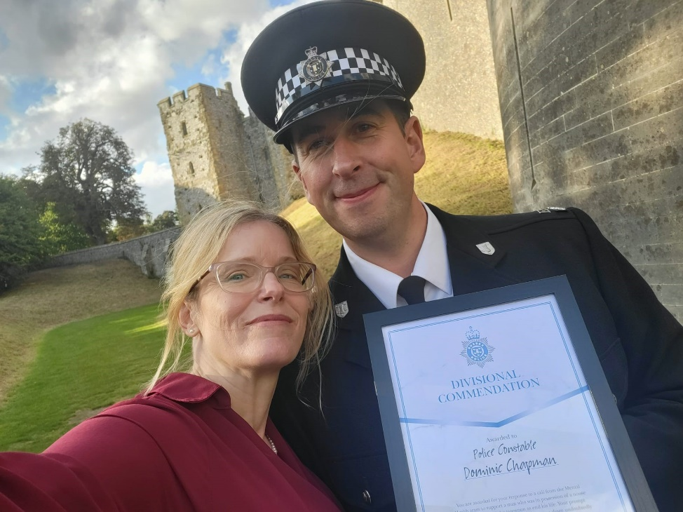
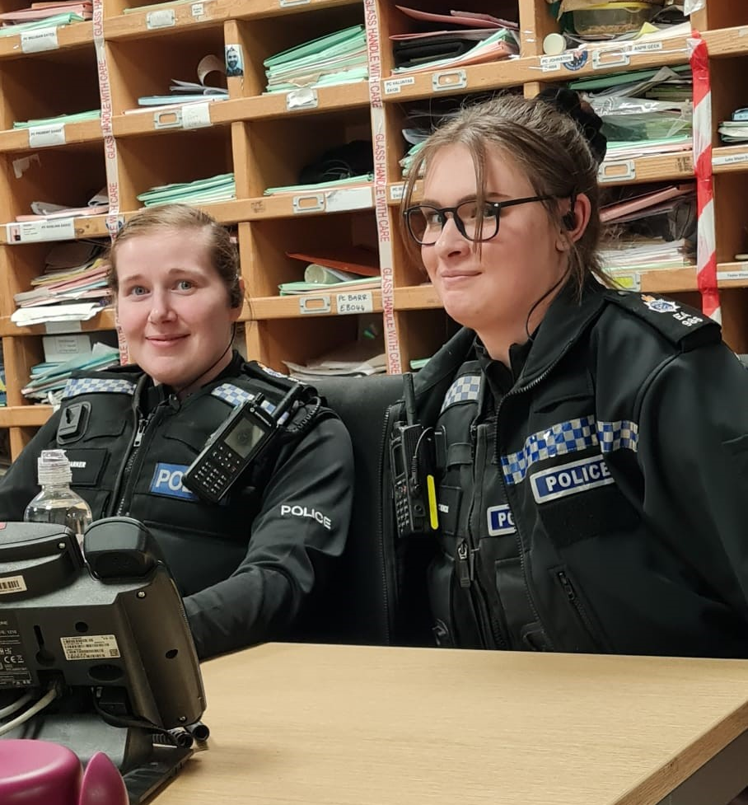
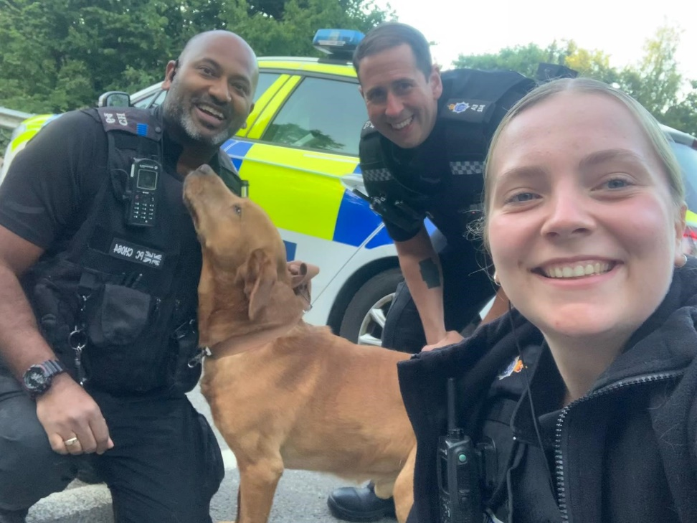
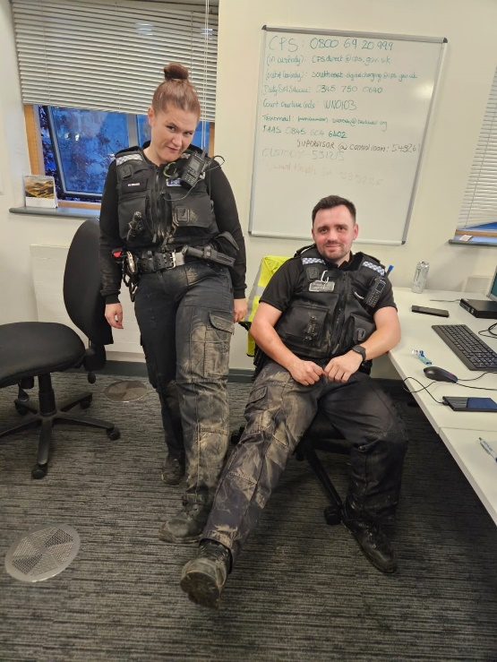
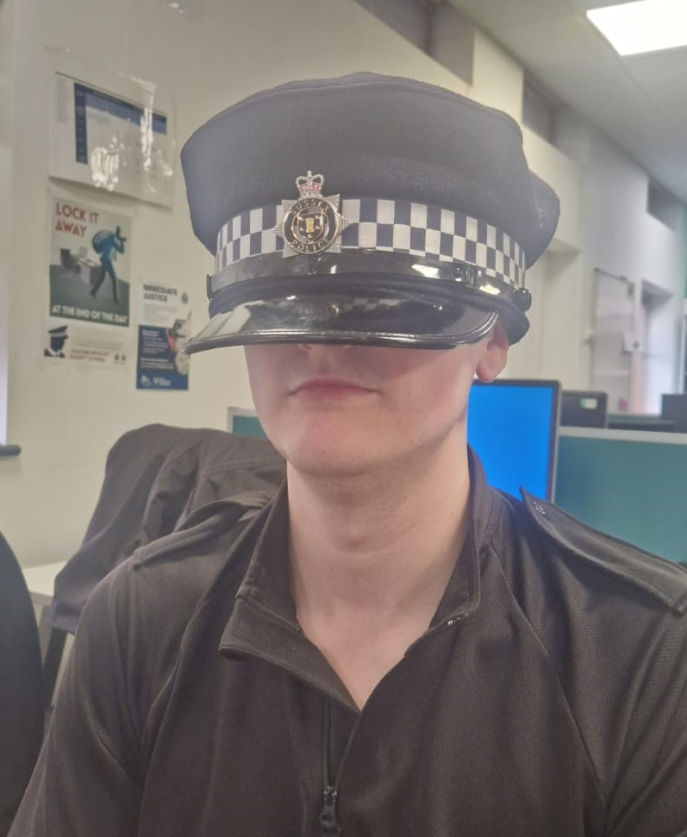
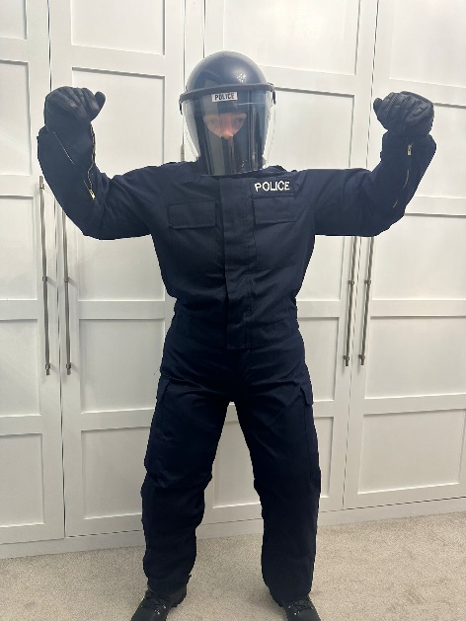
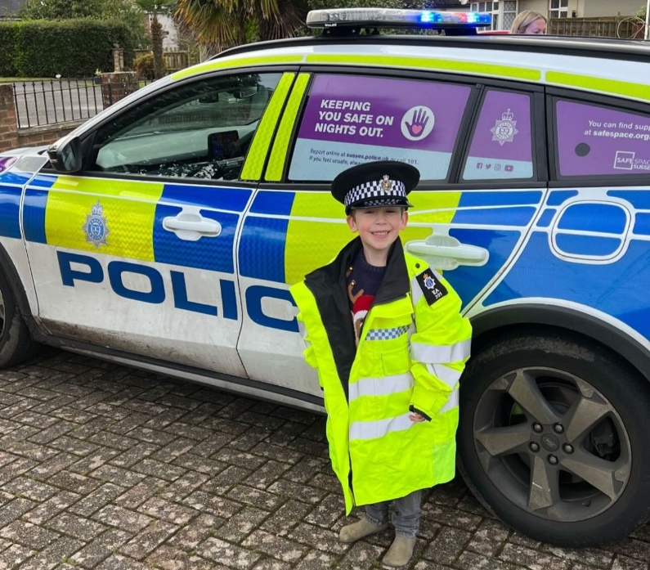
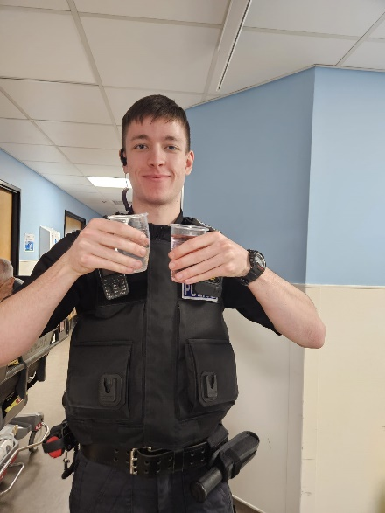
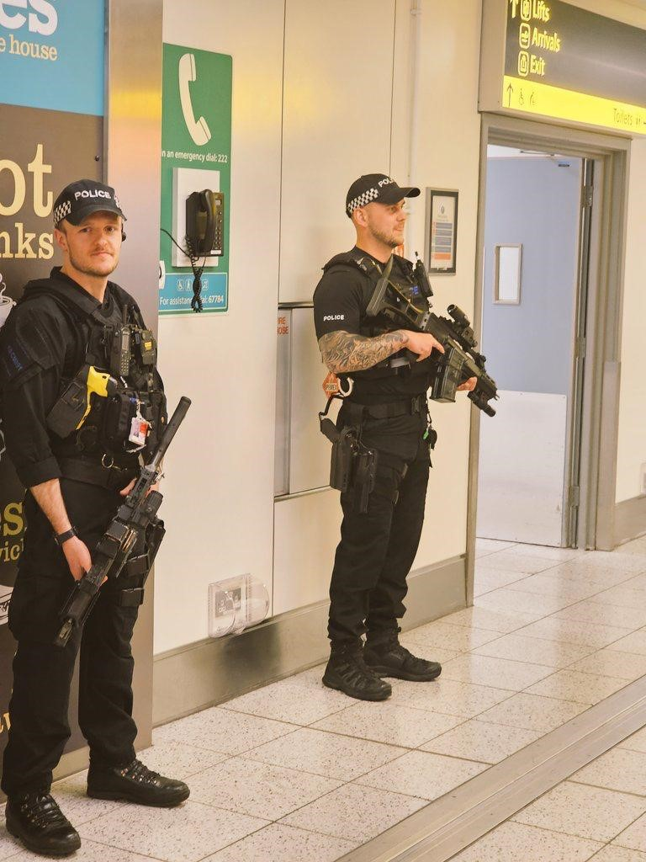
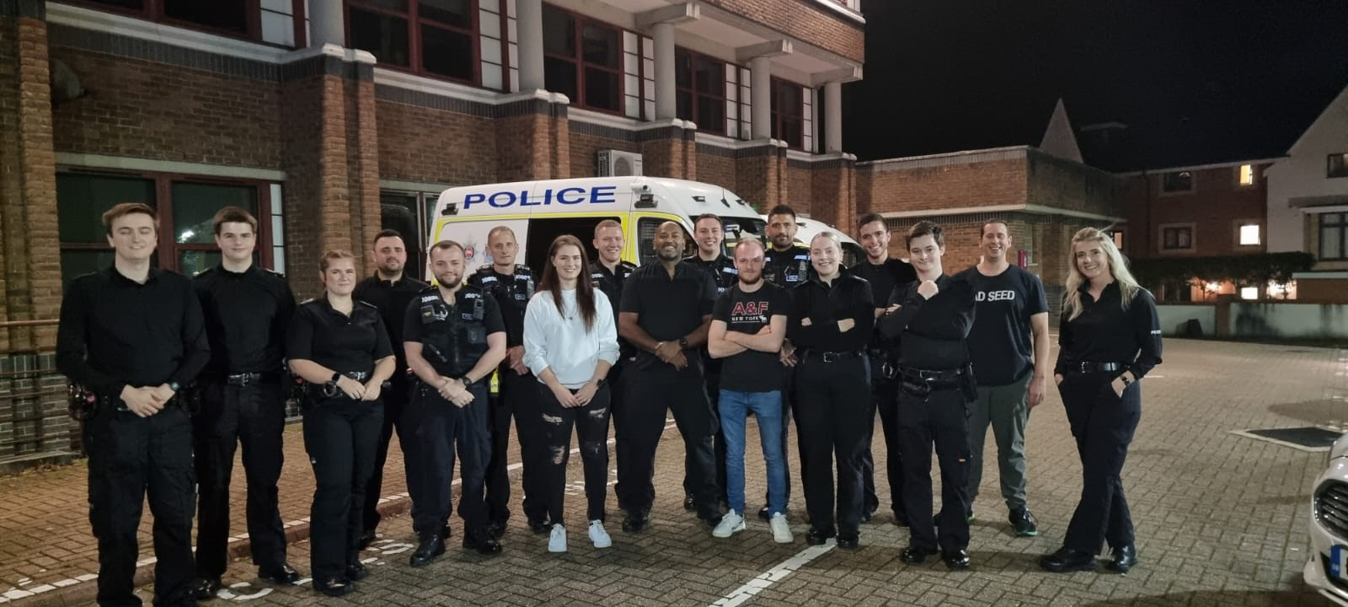
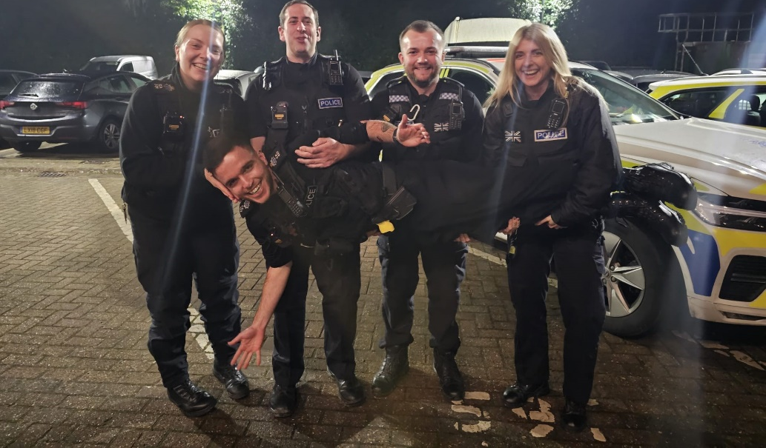

Slide 7

Thank you
Questions and answers

