Slide 1

Post 16 Options after WHS

Slide 2


Post 16 Options-General Info
You have to continue in Further Education or training for two more years
You can choose which option suits you best, but there are so many people that can help you, plus lots of resources - Parents, Carers, Tutors, WHS Careers Advisor, Assemblies, College Open Events, College websites & WHS Post 16 website page. It’s free advice, so please just use it or ask!
You need to be thinking about it now as you have to make your decision and apply in the Autumn term. Applications should be made at the latest by the Xmas holidays and for some colleges earlier than that!
Remember college is different to school in lots of ways and you will normally only have approx. 15-18 hours of lessons per week, but you will take on more self-learning.
Your predicted grades, not target grades are what is used by colleges to assess your suitability for a course(s)

Slide 3

What type of study is best for you?
A Level (level 3) - At college or 6th form
Vocational (can be level 1,2 or 3) - At college or 6th form
Apprenticeship - In the workplace & college
T Levels (level 3) - In college & the workplace
I.B (International Baccalaureate) – At college

Slide 4


What are A Levels?
Well-known level 3 qualification that is offered by colleges & 6th Forms for students after Year 11.
Two year Courses.
You can study 3 or 4 subjects. Most students study 3 due to the academic demands of taking 4.
There are over 40 different A Level subjects and each college offers it’s own choices.
You will normally require a minimum of 5 grade 4’s at GCSE including English & Maths. Each college will have different requirements as will each subject. (eg to study Biology A Level at Worthing College you will need 5 GCSE’s at Grade 4 & above, including a 5 in Maths & a double 6 in Science).
You don’t always need to have studied the subject at GCSE to take it at A Level. This is a great opportunity to try something new.
Most subjects will involve academic work with exams to assess a grade which is also a pass or fail.(similar to GCSE’S)
They are a recognised pathway to Universities.
Colleges offer other Level 3 subjects such as WJEC, CAMTEC or BTEC & can be combined with A Levels. Check college/6th Form school websites as each will have their own criteria.

Slide 5


What are Vocational Courses?
Practical & skill based two year courses including - Health & Social Care, Catering, Bricklaying, Vehicle Maintenance , Childcare, Animal Management, Hairdressing & many more).
You begin at Level 1,2 or 3 depending upon your GCSE grades and in your second year you move onto the next Level. Level 3 moves onto an Extended Level 3 Diploma.
GCSE entry grades will differ for each subject & level of entry. A guide is-
  Level 1 needs 2 @ grade 2 & above.
  Level 2 needs 3 @ grade 3 & above,
  Level 3 needs 4@ Grade 4 & above.
You can only study 1 subject/course but will still have a full timetable.
Results can be assessed by either practical work & exams or sometimes both.

Slide 6


What is an Apprenticeship?
They combine practical training with an employer & study
You will normally need to find these opportunities yourself by approaching an employer and NOT a college
You earn a wage, usually a minimum of £4.15 p/h
Students usually study at a college or a training centre for one day a week.
Entry levels are variable but the usual minimum requirement is 5 GCSE passes at grade 9 – 4, but some companies will accept lower, particularly in Hair & Beauty, Childcare, Catering & Construction.
At the end of a two year programme the employer will often offer you a full time job role depending upon your achievements.
Opportunities can be quite limited at age 16 with more available at age 18.
https://www.gov.uk/apply-apprenticeship

Slide 7


What is a T Level?
Two-year technical study programmes, combining classroom learning alongside an industry placement giving young people the skills that industries need.
The 'T' stands for technical and will give 16 to 19 -year olds a ‘one subject’ technical alternative to A levels.
One T Level is equivalent to 3 A levels so provides a University pathway.
T Levels will offer students a mixture of classroom learning at college and ‘on-the-job’ experience during an industry placement of at least 45 days.
This will provide the knowledge and experience needed to open the door into skilled employment, further study at university or even a higher level apprenticeship.
Different T Levels are available at various sites within Chichester College Group.
List of all of the possible subjects on next slide -

Slide 8
T Level Courses Available From September 2024
You can currently study T Levels in:
animal care and management
catering
craft and design
hairdressing, barbering and beauty therapy
media, broadcasting and production
accounting
agriculture, land management and production
building services engineering for construction
design and development for engineering and manufacturing
design, surveying and planning for construction
digital business services
digital production, design and development
digital support services

Slide 9
T Level Courses (continued)
education and early years
engineering, manufacturing, processing and control
finance
health
healthcare science
legal services
management and administration
maintenance, installation and repair for engineering and manufacturing
onsite construction
science.
animal care and management
catering
craft and design
hairdressing, barbering and beauty therapy
media, broadcasting and production
marketing.

Slide 10


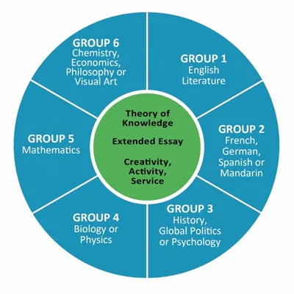
What is an International Baccalaureate (IB)?
This is an academically challenging programme equivalent to Level 3 and can be regarded as an alternative to A levels.
A mixture of at least 7 GCSEs at Grade 6 or above, including English, Maths and Science.
You choose one course from each of six subject areas shown below, three at Higher Level and three at Standard Level. Higher level choices are studied in a lot more detail than Lower level
Offers a diverse range of subjects to study
Recognised by Universities as a pathway to the
Only available locally at Varndean & Christs Hospital
https://varndean.ac.uk/courses/i_bacc/

Slide 11


Local Post 16 Places to Study
We are fortunate to have over 20 Local Colleges & Further Education centres to study, which means there is something for every one of you
See next slides for details of those locally that have provided us with information or please attend our Post 16 evening event, usually held in November -

Slide 12


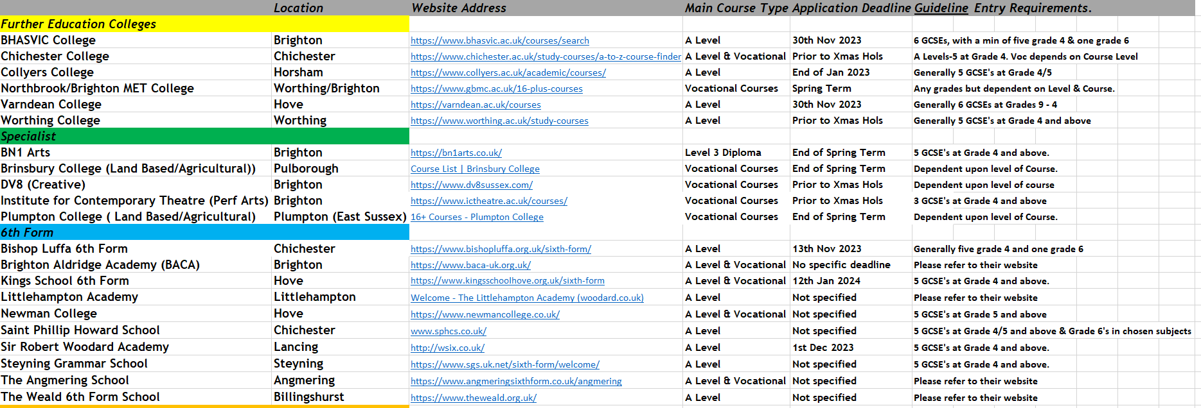
Details of Post 16 Providers

Slide 13
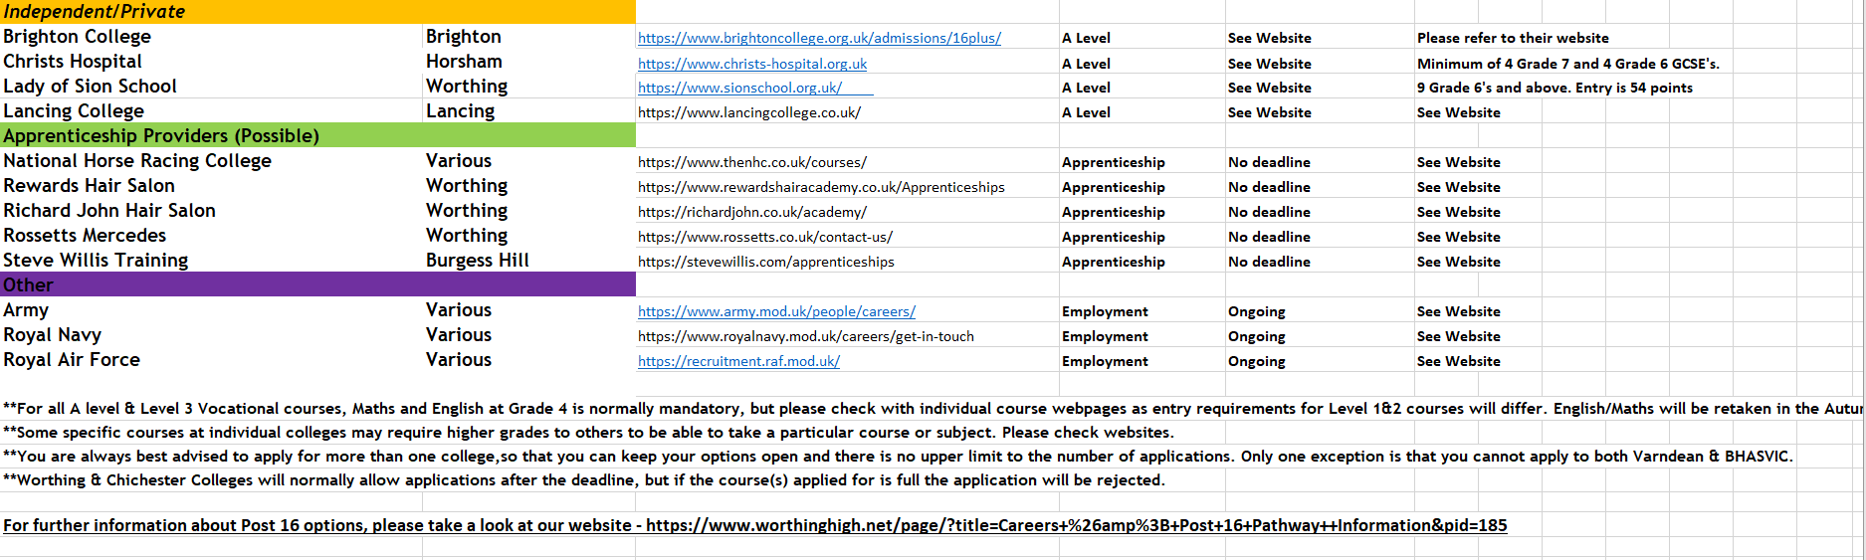
Details of Post 16 Providers(continued)

Slide 14


Hints & Tips
There is no limit to how many college’s you can apply for. (However, you cannot apply to both BHASVIC & Varndean)
You must apply before each College’s Application Deadline.(often this is December!)
College Applications are completed online & often only ask very basic information & take a maximum of 10/15 mins.(Each college is different, some can take 30 mins or more)
You will need to have your Predicted GCSE grades before applying.
Attend Open & Taster Days at the colleges……You are going to spend 2 years there so best to have a clear idea of what it’s like!!
Once you have applied, the college will email you frequently with ongoing important instructions about interviews, etc and expect you to act on those, no one else!!!
Maths & English at Grade 4 & above are very often mandatory, but all students will have to retake in the Autumn term alongside their chosen subject(s) if they do not achieve this, no matter what Post 16 pathway they take.
Following an interview (timescales differ for each college) you will be hopefully be given a ‘Conditional Offer’. This shows the grades you will need. You can accept all or some of your offers, so you have a number of options available to you when you will have to enrol at your chosen one.

Slide 15


Where to go for help?
Mr Fisher in Careers (B1b) is here to help with any Post 16 questions you have. Drop in or request a meeting.
Each of you will also have a 1:1 meeting at some stage through Year 11 to provide you with any help you require, but to get priority, just ask for one!!
All Post 16 & other useful information about your next steps is posted on the WHS webpage.
https://www.worthinghigh.net/page/?title=Careers+%26amp%3B+Post+16+Pathway++Information&pid=185
https://www.worthinghigh.net/page/?title=Year+10%2F11%2DPost+16+Information&pid=184

