Slide 1
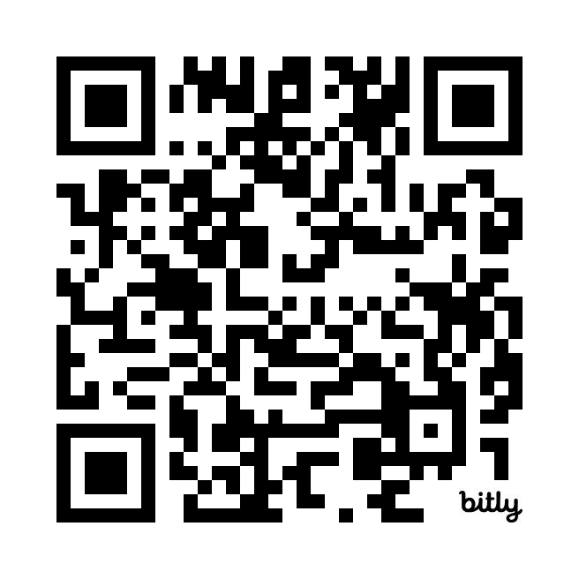
Connectr: GSK’s Candidate Engagement Tool – WORTHING
Helping you get ahead
Sign up to our candidate engagement tool using the QR code
to find out more about our Early Talent Programmes and engage with colleagues
By signing up to Connectr, you can discover:
Who we are and what we do through bespoke and inclusive learning modules on GSK
Application Hints and Tips to support your next steps in applying for roles with us
Mentors or ‘Digital Buddies’ – these are graduates, interns, apprentices and employees available to answer your questions to help you learn more about daily life at GSK
Worthing QR code

